Slide 1

You know we’re all about careers!!

Slide 2
WHAT DO YOU THINK WE DO IN CAREER PLANNING AND DEVELOPMENT?

Slide 3

Open YOUR Mane BOOK TO PAGE 82
We’re Bringing service back…..

Slide 4

NEED A JOB?
The Mane Book, PAGE 84

Slide 5


Picking a major weighing you down?
HELP

Slide 6

SO MANY OPTIONS…….

Slide 7
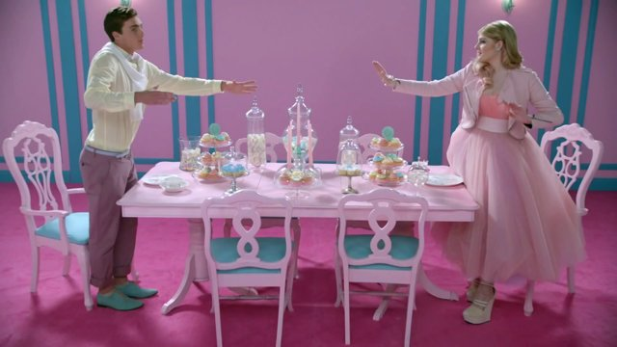
Process of elimination
The Mane Book, Pages 79-81

Slide 8
WILL CONSIDER: +
WILL NOT CONSIDER: -
Not Sure: ?
TIMER

Slide 9
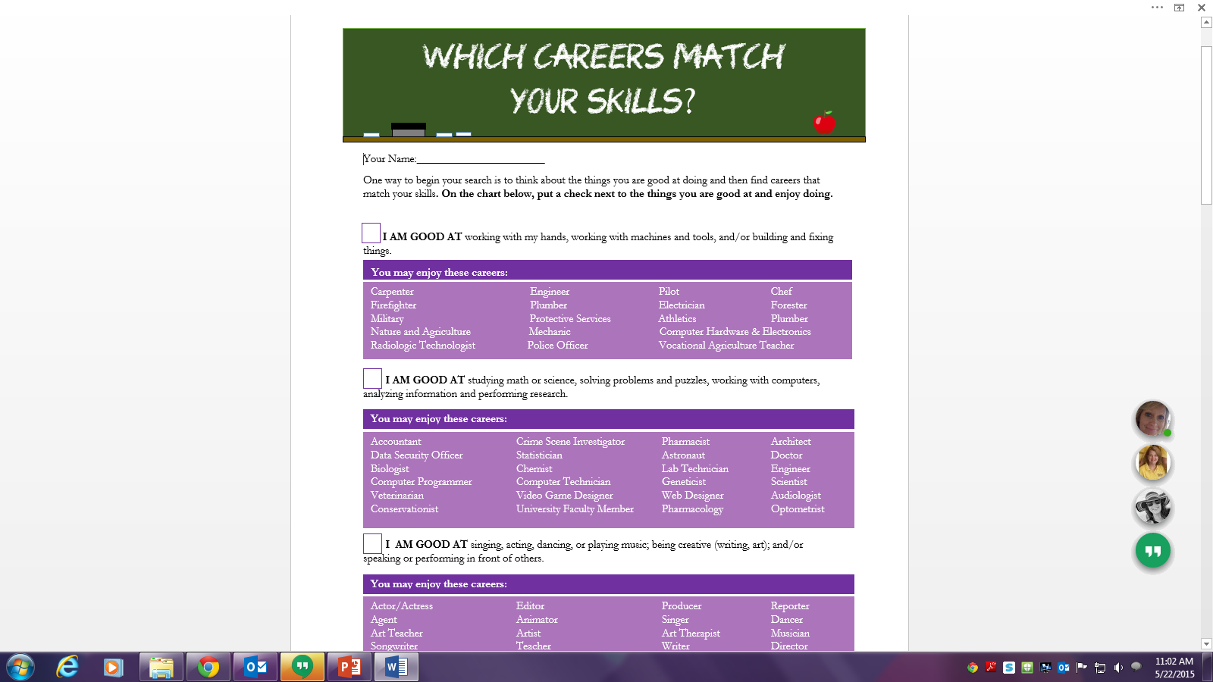

Slide 10



Slide 11

WHAT DO I DO NOW?

Slide 12

YOU have Help:
Career.una.edu
What can I do With my Major?
Candid Careers
Bls.gov
Set up an Appt with CPD Staff!

Slide 13

FAMOUS FAILURES!!

Slide 14



SOCIAL MEDIA
UNA’s Career Planning and Development
@UNACAREER
@UNA_CPD

Slide 15
Questions?

