Slide 1
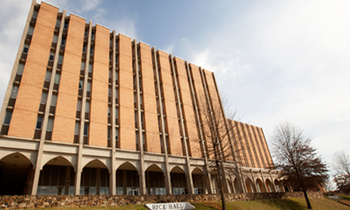


University of North Alabama
Student Counseling Services

Slide 2
Student Counseling Services
Who, What, When, Where
WHO: Licensed Professional Counselors (LPC), Associate Licensed Counselors (ALC), Masters Level Interns, & Administrative Assistant
WHAT: Solution-focused Brief Therapy
WHEN: Monday-Friday 8:00 AM to 4:30 PM
Open/Closed with the University
WHERE: 1st Floor of Rice Hall
726 N. Pine Street
CONFIDENTIAL SETTING
Assessments & Consultations
Individual & Group Counseling
Tele-Mental Health Services
Crisis Interventions
Zen Den Appointments
Campus Referrals
Community Referrals
Presentations & Activities
Wellness Workshops
Virtual Resources

Slide 3
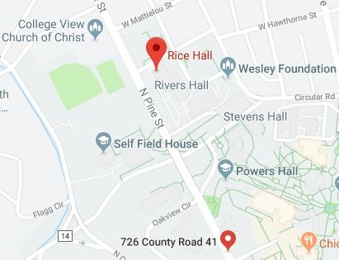

Student Counseling Services
1st Floor Rice Hall

Slide 4
Student Counseling Services
Common Concerns Addressed
Adjustment/Transition
Alcohol/Other drugs
Anger management
Anxiety/Stress
Depression/Mood disturbance
Eating/Body-image concerns
Grief/Loss
Gender identity/expression
Relationship Conflicts
Sexual/affectional orientation
Spirituality
Suicidality/Safety concerns

Slide 5
Student Counseling Services
Common Concerns Addressed
Adjustment/Transition
Alcohol/Other drugs
Anger management
Anxiety/Stress
Depression/Mood disturbance
Eating/Body-image concerns
Grief/Loss
Gender identity/expression
Relationship Conflicts
Sexual/affectional orientation
Spirituality
Suicidality/Safety concerns
TOP CONCERNS

Slide 6
Student Counseling Services
Appointments
SCS is now offering Tele-Mental Health sessions via Zoom Healthcare as a first line of service to all actively enrolled UNA students.
Call SCS at 256-765-5215
Complete Phone Assessment & Screening
Follow-up with Individualized, Stepped Care Recommendation:
HIPPA compliant
Lion Chats/Same day Sessions
Individual Counseling
Group Counseling
Self-help Psychoeducation
Emotional Wellness Workshops
Virtual Mental Health Resources
Campus/Community Referral
Zen Den Appointments
AVAILABLE: MON-FRI from 8:00 AM to 4:30 PM
Counselor on sight for emergent needs during regular business hours.
UNA MANE CARD required for appointments & building access.

Slide 7


Student Counseling Services
Resources & Media
V I S I T una.edu/counseling
F O L L O W @una_scs
F O L L O W @unastudentcoun1
for service information, mental health resources, & virtual coping strategies

Slide 8
University of North Alabama
Student Counseling Services
1st Floor of Rice Hall | 256.765.5215

