Slide 1
Cooperating Teacher Training
Purpose: The cooperating teacher training, along with the handbook, will serve as a reference tool and guide during the student internship experience. Please take the opportunity to carefully read through the presentation in order to gain an understanding of the university’s policies and procedures. The University Supervisor and Office of Clinical Experiences promises to support you in this crucial role throughout the placement. Please contact us at anytime should you need assistance.

Slide 2
Welcome Letter
A “welcome letter” will be sent to all cooperating teachers. Please review the letter, add the dates to your calendar, and use the resource links provided.
Instead of hosting scheduled Zoom meetings, I will be sending out monthly emails with supports and reminders.
This Photo by Unknown Author is licensed under CC BY-NC

Slide 3
How to get off to a great start!
Feedback (positive and constructive) Please don’t be afraid to be honest. This can be done verbally, with sticky notes, or formally using our field assessments form.
Weekly planning time-- Set aside a block of time each week to plan. An intern’s plans are submitted to us the week before they teach any content. This allows you and the supervisor time to correct errors.
A separate space from you for their items (small desk area, etc.)
Communication—if you are not happy with management, attitude, etc. Speak up and let them know! Then, work together to find a solution that works for both of you.
Remember—they are a novice teacher. Help them through the mistakes, don’t expect them to teach or know the content like you, and train them to be the next generation of teachers!

Slide 4
Quick Review of the Internship Handbook
A full copy of the handbook can be view at this link:
HANDBOOK LINK
Interns are to exhibit dispositions at all times in the classroom setting.
Notification of an absent should be submitted by 7:00 AM. All absences must be reported through an email to the supervisor, cooperating teacher, and Christy Waters.
Interns should not request to leave early for employment reasons.
Interns must be well dressed and groomed at all times.
Interns are not allowed to teach any content without pre-approval of lesson plans from the cooperating teacher and supervisor.
Interns are not the teacher of record and cannot be left alone as the substitute teacher.
Interns should attend professional development with you. PD days are not off days.
Interns are required to attend school events outside of the regular school day (PTO, open house, parent conferences, etc…).

Slide 5
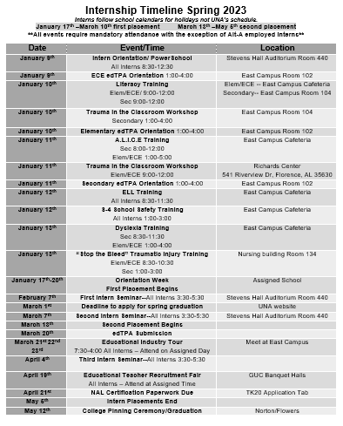
Internship Calendar Internship Handbook Page: 5
Interns follow the school’s calendar and not UNA’s calendar
Interns should share edTPA dates/times with you.
Interns must return to campus for mandatory meetings and seminars

Slide 6
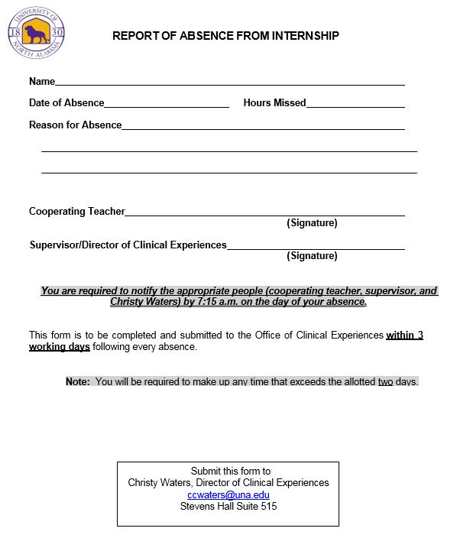
Absences From Internship Internship Handbook Page: 7
Interns are expected to be in attendance everyday throughout the entire period of the internship.
NO absences—with the exception of serious personal illness of the intern or death of an immediate family member. These absences must be documented through the Director of Clinical Experiences, university supervisor, and cooperating teacher.
Tardy Policy: Interns are expected to be in their assigned classrooms every day at the same designated time as the cooperating teachers. A tardy is considered a half day absence. If illness or an emergency makes it necessary for you to be tardy from the internship assignment., notify the cooperating teacher/school prior to the beginning of the school day.
A form of absence is required anytime the intern misses time from the classroom. This form is shown above and must be signed by you. Please report to the University Supervisor if any of the procedures are not being followed correctly.

Slide 7
Solo Teaching Days The university supervisor will work with you to decide the best schedule for solo time.
Interns are required to solo teach 10 consecutive days and maintain full responsibilities of the classroom at least 20 days.
Split Placements: Early Childhood, Collaborative, and P-12 majors (PE, Band, Choral)--10 days per placements for a total of 20
Full Semester Placements: Elementary, Secondary, Some Band—10 consecutive days and 10 flex days (flex days do not have to be consecutive and represent days the intern is teaching for the full school day)

Slide 8
Solo Time—Question/Answer
What is solo teaching? Interns are required to solo teach as part of their graduation and certification requirements in Alabama. Solo teaching provides the opportunity for an intern to have full responsibility of planning, managing, and teaching in the classroom setting under the guidance of a cooperating teacher.
While the intern is soloing, is it required that I leave the classroom? No, our students are guest in your classroom and each teacher can make that decision. Cooperating teachers should check with their building administrator for further guidance. We do ask that an intern not be left for extended periods of time.
Does solo teaching mean I am unable to step in as needed or teach along side my intern? No, you are always welcome to step in or correct content errors. We request that it is done in a respectful and constructive way. If the university supervisor is observing, we ask for you not be involved in the lesson.
What needs to be done if the intern is overwhelmed and unable to solo teach? The first few days of solo teaching can be difficult for an intern to manage and may require additional support from the cooperating teacher. Interns are novices teachers and will need consistent constructive feedback after mistakes are made. If the intern’s soloing teaching is negatively affecting student learning, we ask that immediate contact is made with the university supervisor. As a team, we will co-construct a remediation plan and provide extra supervision. In extreme cases or at the request of the cooperating teacher, the intern will be removed from the placement.

Slide 9
Co-Teaching Model Co-Teaching is defined as two teachers working together with groups of students – sharing the planning, organization, delivery and assessment of instruction, as well as the physical space. The co-teaching model of student teaching allows students increased opportunities to get help when and how they need it that is not possible with just one teacher. Co-teaching with a student intern also provides them with a rigorous experience and allows cooperating teachers the ability to remain actively involved.
Planning:
 What content to teach
 What co-teaching strategies to use
 Who will lead different parts of the lesson
 How to assess student learning
 Materials and resources
Instruction:
 Share leadership and manage the classroom together
 Work with all students
 Be seen as equal partners
 Make changes as needed during a lesson
Assessment:
• Both participate in the assessment of the students
• Share the workload of daily grading
• Provide formative and summative assessment of student

Slide 10
Co-Teaching Models
One Teach, One Observe – One teacher has primary instructional responsibility while the other observes. The key to have specific things to observe—questioning, management, assessment, etc.
One Teach, One Assist – One teacher has primary instructional responsibility while the other assists students with their work, monitors behaviors, or corrects assignments.
Station Teaching – the co-teaching pair divide the instructional content into parts and the students into groups. Groups spend a designated amount of time at each station. Often an independent station will be used along with the teacher led stations.
Parallel Teaching – Each teacher instructs half the students. The two teachers address the same instructional material and present the lesson using the same teaching strategy. The greatest benefit to this approach is the reduction of student to teacher ratio.
Supplemental – This strategy allows one teacher to work with students at their expected grade level, while the other teacher works with those students who need the information and/or materials extended or remediated. (small groups)
Team Teaching – Using a team teaching strategy, both teachers are actively involved in the lesson. From a students’ perspective, there is no clearly defined leader – as both teachers share the instruction, are free to interject information, and available to assist students and answer questions.

Slide 11
Special Circumstances
Departmentalize Teachers
Elementary interns are being certified in all subject areas and must have experience in each content area. The University Supervisor will provide assistance in working out the best plan for rotating among the other team members. Only the cooperating teacher assigned to the intern must hold a masters degree and three years of teaching experience.
Last Period Planning-Leaving Early
Interns are never permitted to leave placement before the end of the school day. They should not stay in the classroom if the cooperating is off campus. Interns can either move to common work areas (workroom, library) and finish planning or rotate to another teacher’s classroom within their content area.

Slide 12
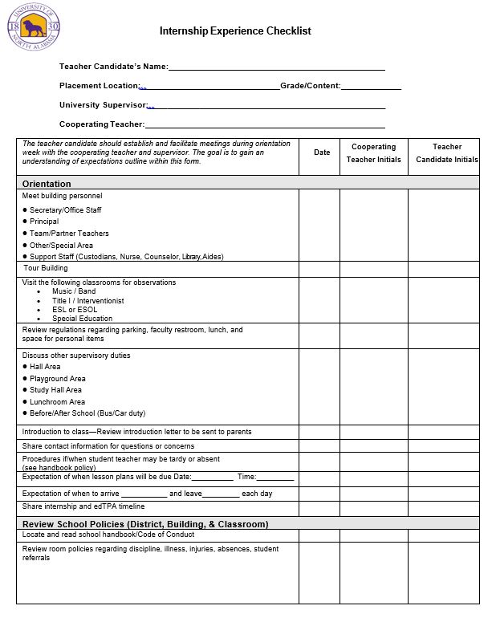
Internship Experience Checklist
Interns will work with their cooperating teacher to complete the Internship Checklist. Please be sure all expectations are set during orientation week. A copy of the checklist can be found in the internship handbook on page 25-27.

Slide 13
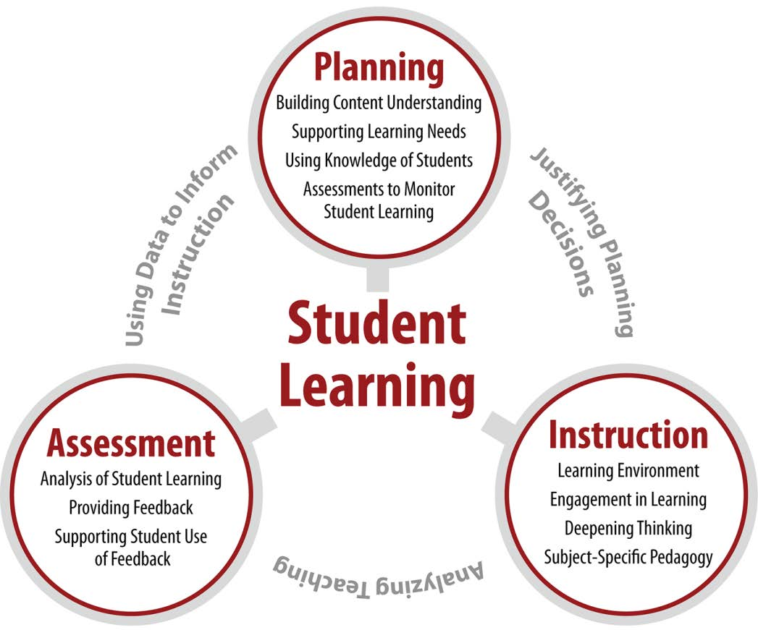
What is edTPA? Internship Handbook Page 14 Interns will provide and discuss an additional handout (CT Packet) First placement only
edTPA is a performance-based assessment that provides evidence that teachers beginning their careers are ready to teach
edTPA focuses on three areas critical to effective instruction: Planning, Instruction, and Assessment
edTPA is consequential for licensure in Alabama beginning in the fall of 2018
To learn more please visit: edTPA Site

Slide 14
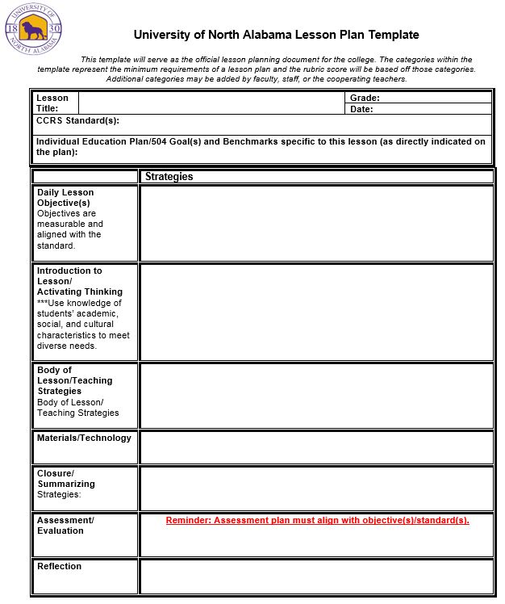
Lesson Plan Template
Internship handbook page 22
**University Supervisors and Cooperating Teachers must approve all lesson plans prior to the content being taught in the classroom. Under no circumstances is an intern allowed to teach without an approved lesson plan. **
**The lesson plan template represents the minimum categories for lesson planning in the P-12 classroom setting. All interns must use the template shown for all lessons.**

Slide 15
Grading Procedures for Internship
Upon completion of the internship, supervising faculty will issue a letter grade for the internship semester.
Internship grades will be based on the chart below unless otherwise communicated by the supervising professor. Cooperating teacher evaluations are factored in the final grade.
NOTE: If an intern has not completed all requirements assigned by the Office of Clinical Experiences, they will receive an Incomplete in their Internship until all outstanding requirements are satisfied.
Class B (12-hour course) Class A (9-hour course) **Collaborative majors will receive two grades for internship (Elem Ed placement and Collaborative placement)
Faculty Evaluations, 50% edTPA Completion/Teacher Work Sample, 30% Dispositions/Professionalism, 20%

Slide 16
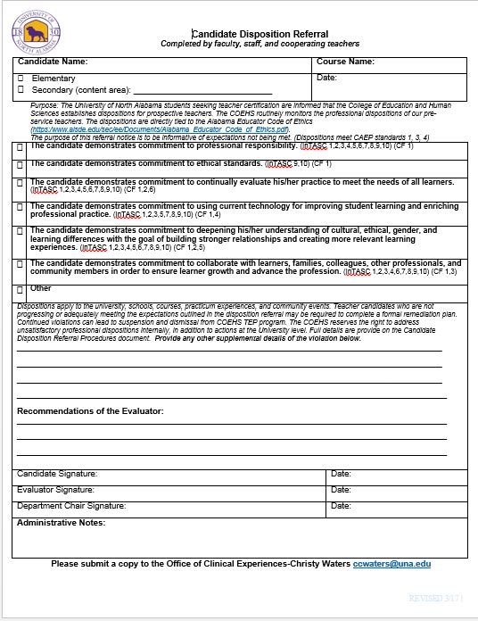
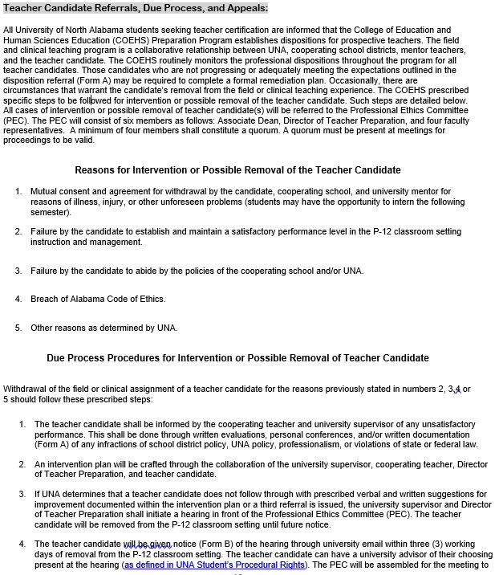
Candidate Disposition Referral Form
Teacher candidates who are not progressing or adequately meeting the expectations outlined in the disposition referral may be required to complete a formal remediation plan. The referral should be issued to a teacher candidate if concerns arise during the internship placement. Please follow the procedures for issuing a referral and contact the university for support.
The disposition referral procedures are found in the handbook on page: 10. This document will provide step-by-step instructions for using the referral form.
The candidate disposition referral form is located in the handbook on page: 24. Please be sure to read through all procedures and ask questions if needed. It is imperative that teacher candidates are made aware of classroom expectations that are not being met.

Slide 17
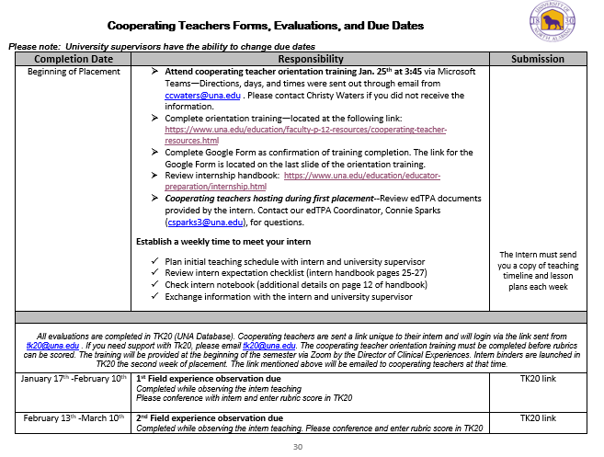
What Assessments do I complete as a Cooperating Teacher?
All internship evaluations will be completed in Tk20. A link to your intern’s assessments has be sent to your email. The chart to the right contains the due dates for assessments. It is located in the handbook on page 30.

Slide 18
**Rubric Training for Cooperating Teachers**
Please copy and paste the link in your browser. It will not work directly from the presentation.
https://docs.google.com/presentation/d/1vgTKEWpYdH-Y3AY6uSyTrCu0ki9xTSSeiTW1_Yjo6GA/edit?usp=sharing
All cooperating teachers are required to work through the rubric training.

Slide 19
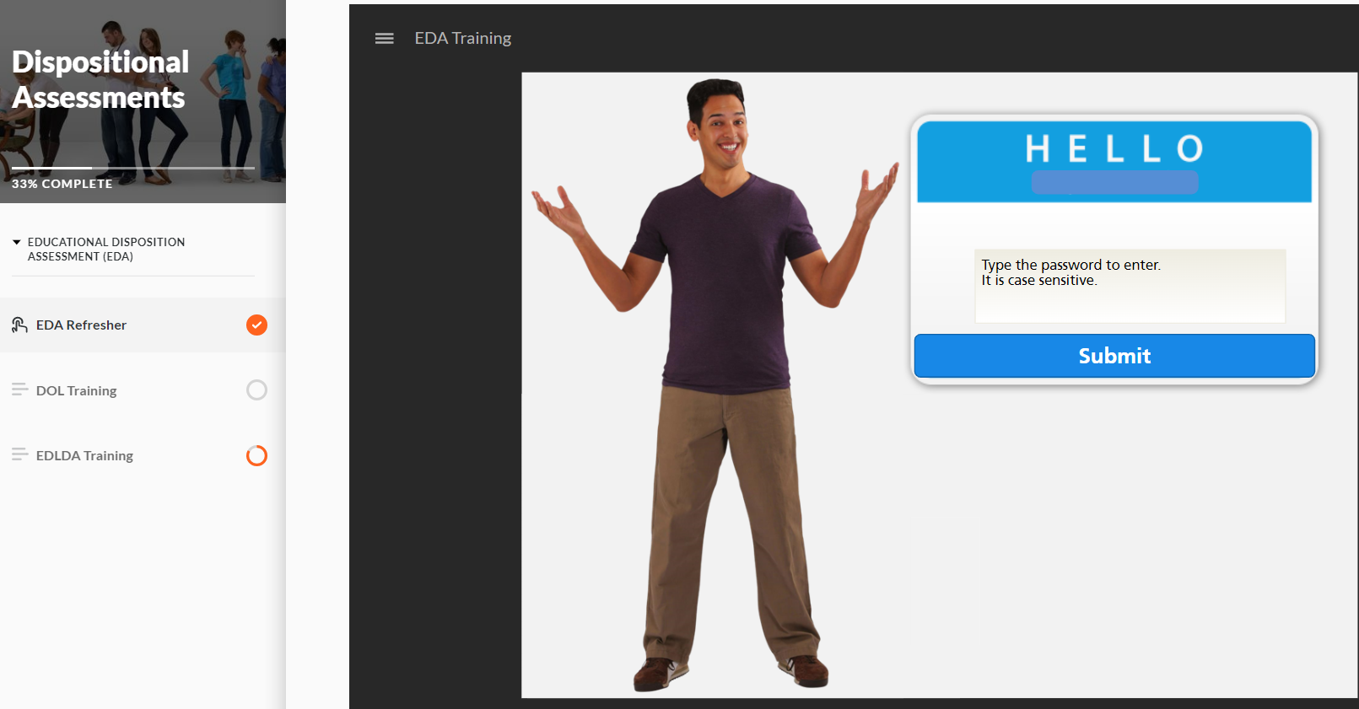
Educational Disposition
Educational Disposition Assessment (EDA) Refresher training—All cooperating teachers should work through the link.
Please copy and paste in your Browser.
https://rise.articulate.com/share/wBVXnbi089rioLgxOOdJYg6vSxIkU3fC#/
All passwords are case sensitive and contain no spaces. The password for the course is: DA
Once inside the site, select EDA Refresher radio button on the left hand side (be sure to click the actual button and not just the word). You should see EDA Refresher on the main screen, scroll down, and play the video. You should see the screen to the right. Once there, the password to enter the training is EDA
Assessment (EDA) Training

Slide 20
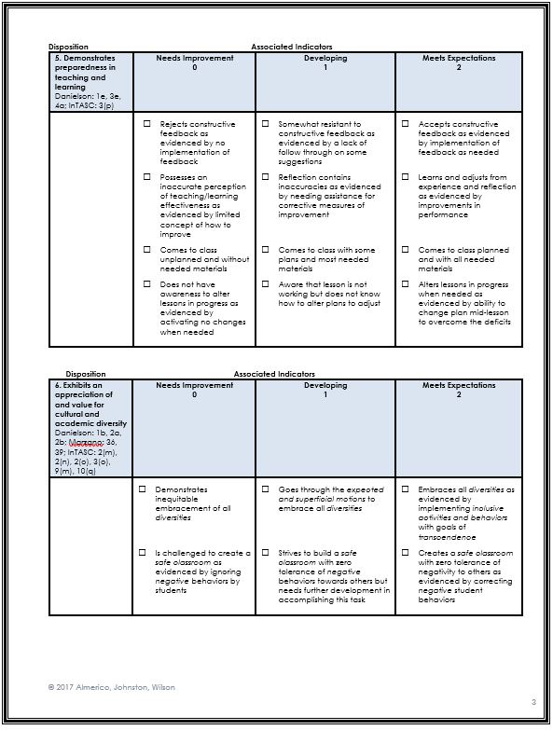
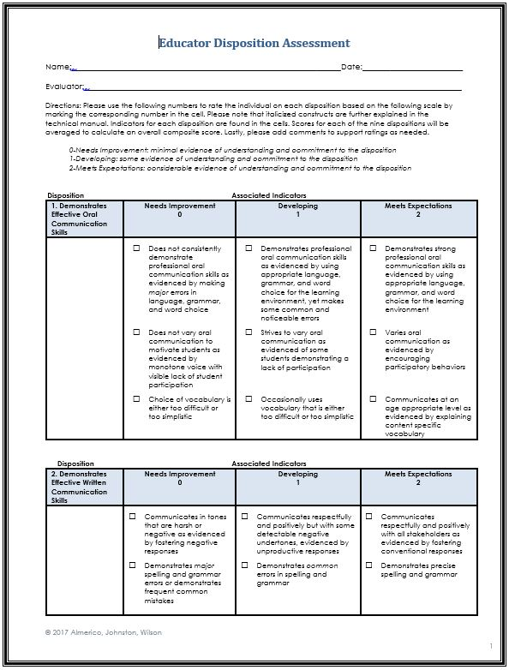
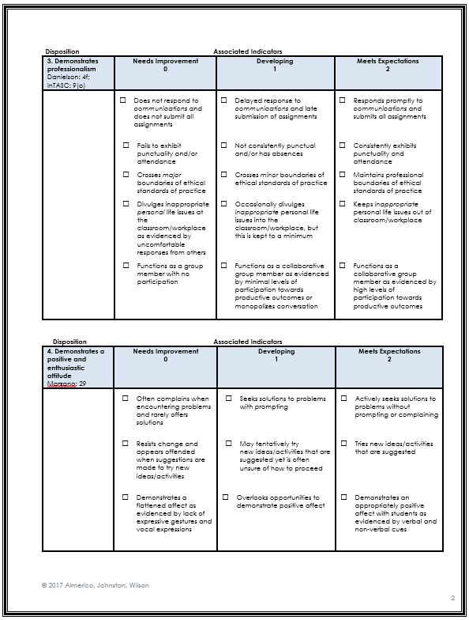
EDA Rubric

Slide 21
Training Record—Final Step
When you have completed the cooperating teacher training and EDA refresher course, please complete the Google form as a recording of your trainings.
Please copy and paste the link: https://forms.gle/ixrb1U1ScG8ph6MT7

Slide 22
Thank you for participating in the training session!
Christy Waters Director of Clinical Experiences ccwaters@una.edu
256-443-3166
Questions

