Slide 1
Course Waitlisting

Slide 2
Overview
Students add a waitlisted course through the Registration feature in Self-Service Banner located in the UNA Portal
Prerequisites and other registration restrictions apply for waitlisting with the exception of duplicate course sections and time conflicts
Students are notified through their portal email when a seat becomes available
Students are pulled from the waitlists on a first-come, first-served basis

Slide 3
Overview Continued
Once a seat becomes available, a student has 24 hours to register for the waitlisted course
If a student does not register, he or she is removed from the course waitlist and the next student on the waitlist is notified
Waitlisting will be available up until the last day of drop/add

Slide 4
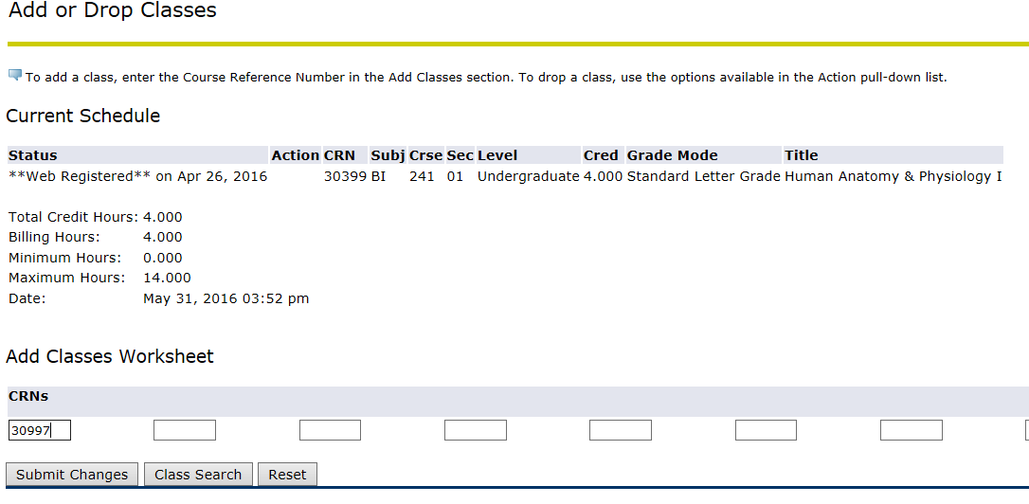
How To Add a Waitlisted Course
In Self-Service Banner, click on the Add/Drop Courses option
Enter the CRN number in the Add Classes Worksheet and click Submit Changes

Slide 5
How To Add a Waitlisted Course (con’t)
Under the Action field, click on Add to Waitlist and click Submit Changes

Slide 6
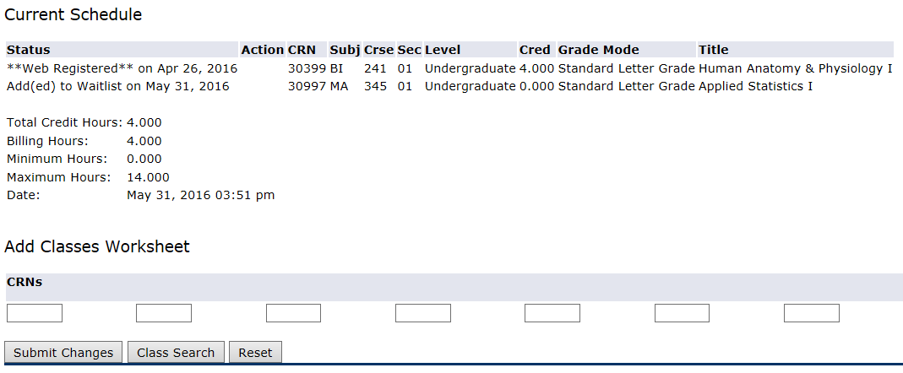
How To Add a Waitlisted Course (con’t)
Under the Status field, it should read the student was added as waitlisted

Slide 7
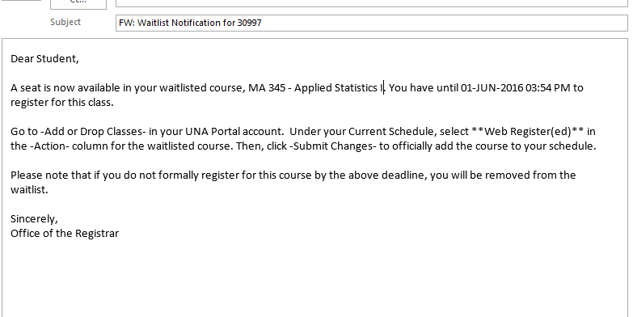
Notification
Once a seat becomes available, an email notification will be sent to the student’s UNA Portal email account, and it will include the registration deadline date and time

Slide 8
How To Register for a Waitlisted Course
To register for the waitlisted course, click on the Add/Drop Courses option in Self-Service Banner
Select **Web Registered** from the Action dropdown field and click Submit Changes

Slide 9
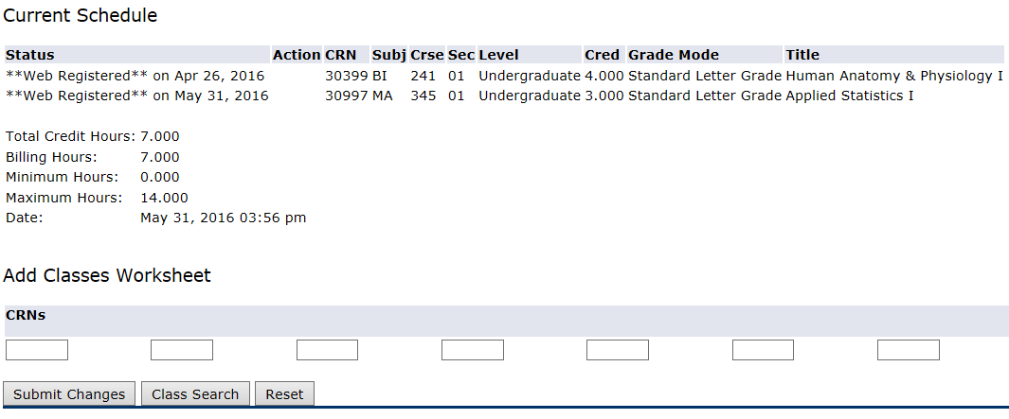
How To Register for a Waitlisted Course
Under the Status field, it should read that the course is now **Web Registered**

Slide 10
Questions
Contact
The Office of the Registrar
Registrar@UNA.edu

