Slide 1
Assessment Toolbox: Multiple Tools for Assessing Effectiveness in Higher Education
Dr. Andrew L. Luna
Institutional Research, Planning, and Assessment
University of North Alabama

Slide 2
Contact Information
Dr. Andrew L. Luna
Director
Institutional Research, Planning and Assessment
University of North Alabama
256-765-4221
alluna@una.edu

Slide 3

Assessment?

Slide 4
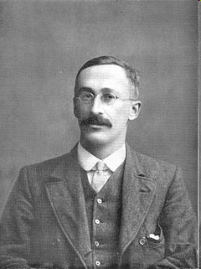
Gosset, Beer, and Statistics…
William S. Gosset (1876-1937) was a famous statistician who worked for Guiness. He was a friend and colleague of Karl Pearson and the two wrote many statistical papers together. Statistics, during that time involved very large samples, and Gosset needed something to test difference between smaller samples.
William Gosset

Slide 5
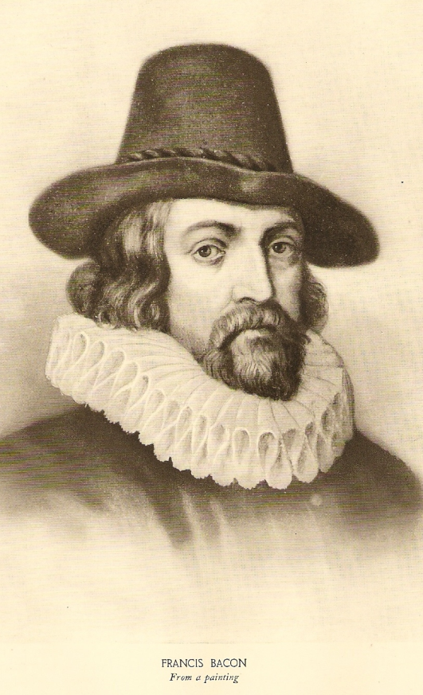
Sir Francis Bacon
Francis Bacon (1561 –1626) was an English philosopher, statesman, lawyer, jurist, and author. Although not primarily known as a scientist, Bacon wrote a philosophical work called Novum Organum 1620. In it, he detailed a new system of logic called the Baconian method. This book was foundational to empirical thinking and inductive reasoning.
Note: A statistical test called the Chi Square was later used to determine if Bacon wrote plays attributed to William Shakespeare

Slide 6
Points of Discussion
The origins of outcomes measures and continuous improvement
What is improvement?
The fact that surveys and nationally normed tests are not the only methods of successful assessment
Examples of how outcomes measures are used in the improvement process within higher education
Questions

Slide 7
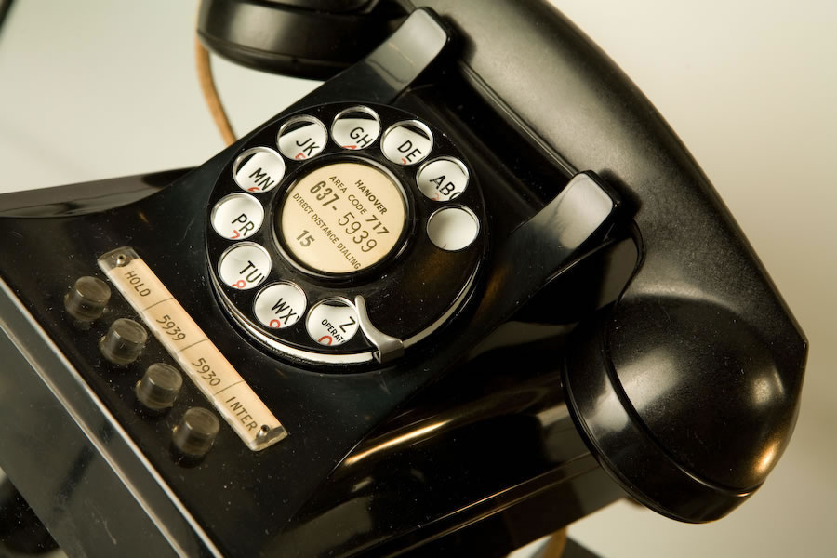
Connections to IE?

Slide 8
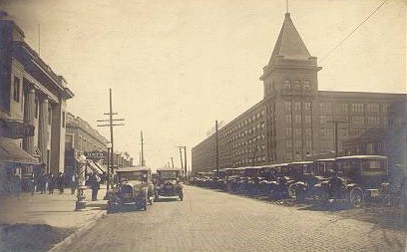
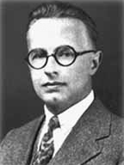
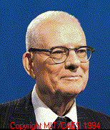
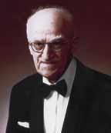
Telephones and IE?
Walter Shewhart
Edwards Deming
Joseph Juran
Hawthorne Works, Bell Laboratories

Slide 9
Shewhart Cycle
Plan
Continuous
Improvement
Act
Do
Check
FACT...
The Shewhart Cycle is the foundation for all quality and
Continuous improvement processes that we use today

Slide 10
More on the Shewhart Cycle
Plan – Create a strategy as to what you want to do and how you will measure success
Do – Follow the plan and do what you say you will do
Check – Assess the effectiveness of the current plan by looking at the success outcomes measures
Act – Make changes to the strategies to improve the measured outcomes
Repeat the Cycle!

Slide 11
Why is the Shewhart Cycle Important?
If you can’t measure something, you can’t understand it…
If you can’t understand it, you can’t control it…
If you can’t control it, you can’t improve it…
If you can’t improve it…then why the heck are you doing it?

Slide 12
Shewhart Cycle and SACS
Check and
Act
Planning
Core Requirement 2.5:
The institution engages in ongoing, integrated, and institution-wide research-based planning and evaluation processes that (1) incorporate a systematic review of institutional mission, goals, and outcomes; (2) result in continuing improvement in institutional quality; (3) demonstrate the institution is effectively accomplishing its mission
Do

Slide 13
Shewhart and SACS, Cont.
Plan
Comprehensive Standard 3.3.1:
The institution identifies expected outcomes for its education programs … and its administrative and educational support services; assesses whether it achieves those outcomes; and provides evidence of improvement based on analysis of those results
Do and Act
Check

Slide 14
Shewhart Modified…DMAIC
DMAIC: Expands upon Shewhart and is the method used to improve the current capabilities of an existing process. This is by far the most commonly used methodology of continuous improvement teams.

Slide 15
DMAIC Methodology
Define – Identify, prioritize, and select the right project(s)
Measure – Identify key outcomes measures, process parameters, and measure performance
Analyze - Identify the key (causative) process determinants
Improve – Establish prediction model, DOE, or other improvement tool and optimize performance
Control – Hold the gains

Slide 16
Outcome Focus
Define
The right outcome(s), the right team(s)
QEP?
Measure
Process
Problems and Symptoms
Process outputs
Response variable, Y
Process
Characterization
Y
Analyze
Independent variables, X_{i}
Process inputs
The Vital Few determinants
Causes
Mathematical relationship
Process
Optimization
X’s
Improve
Control
Goal: Y = f ( x )

Slide 17
Inputs, Processes, and Outcomes
Measurement
Materials
Methods
X’s
X’s
X’s
X’s
Y’s
Input
Outcomes
X’s
X’s
X’s
Environment
People
Machines

Slide 18
Customers: A Traditional Model
Academic, Ed. Support, Admin.
Students
Systems and Processes
Gradates
Employers
Grad Schools
Licensure
High
Schools, Business
Inputs
Outputs
Suppliers
Customers
Knowledge Bank
Feedback
Feedback
In Higher Education, Students Are Pseudo-Customers

Slide 19
Data and Assessment Examples
All examples were taken from assessment projects within actual colleges and universities
These examples (from simple to complex) show only a fraction of the assessment tools available
Most of these examples require no to little statistical training

Slide 20
Trend Analysis for English

Slide 21
Financial Aid Process Charting
Too many mistakes by applicant
US Government Form: ‘nuff said
Bottleneck of applications to be reviewed
Measurement
Materials
Methods
Pick up application in box. Very little assistance
Y = Time
Submitted
Application
Completed
Application
Too few staff and too many applications
Computer entry errors
Environment
People
Machines

Slide 22
In-House Satisfaction Survey: Importance and Satisfaction
Availability of Major
National Reputation
State-Wide Reputation
Quality of Undergrad Ed.
Cost to Attend
Scholarship Availability
Warm/Friendly Campus
Access to Faculty
Small Student/Faculty Ratio
Safe Campus
Selective Admissions Standards
Athletic Programs
Quality of Faculty
Job Placement
Social Events
Leadership Development
Honors Program
Distance from Home
Distance from Metro Area
Quality of Facilities

Slide 23
Satisfaction Survey Results: Gap Analysis
Measures both the Importance and Satisfaction of a particular variable or attribute
The Performance Gap is the difference between the Importance Measure and the Satisfaction Measure
The higher the Performance Gap, the least institution is meeting customer expectations

Slide 24
Alumni Marketing Survey Results
Interpreting the Radar Chart
Meeting Expectations
Larger Gap
Smaller Gap
Exceeding Expectations/Possible Overkill

Slide 25
Student Satisfaction and Radar Charts

Slide 26
ANOVA – Example
College of Education used an evaluation questionnaire to determine the level of competence a student teacher exhibited toward required dispositions/characteristics
The evaluation was completed by students, faculty members, and teachers in the classroom
ANOVA was used to determine difference between the three groups

Slide 27
Measurement of Differences for Teacher Education

Slide 28
Pareto Chart in Residence Halls
Residential Life Incident Reports – 2 Years
80%

Slide 29
Pareto Chart with Trend Analysis
Trend Analysis

Slide 30
Learning Outcomes
Outcome: Students completing the main sequence general chemistry CHEM1110/1120 will be able to demonstrate a thorough knowledge of general chemistry as evidenced by an average score exceeding the national average on the national ACS General Chemistry Exam.
Assessment: ACS General Chemistry Form

Slide 31
Historical Performance of ACS Score (Y)

Slide 32
What X Variables Contribute to ACS Exam Score?
SAT Math
HSGPA
Classroom Content
Laboratory Work
Homework
Newly designed workshop

Slide 33
Regression Analysis
Run two regression analyses where final grade and the ACS scores were the Y’s
Observe the relationships between the X variables and the Y’s
Develop a Path Analysis to better understand both the direct and indirect relationships

Slide 34
Path Analysis for Chemistry
.1105
WS
.3919
HSGPA
.2024
SATM
.1555
.6665
.1095
.3136
.4918
.5631
GRADE
ACS
.6665
.7675
U_{G}
U_{G}
.5430

Slide 35
Hot Water Problem in Residence Halls
Survey found that most residents in a female hall were unhappy with the bathrooms
Subsequent focus groups found that residents were upset over the quantity and quality of hot water
Define – Hot water variability in high-rise residence hall
Measure – Record temp. of hot water on high, med., and low floors for two weeks, three times a day
Analyze – Plot hot water on X-Bar/R Control Chart

Slide 36
Control Chart for Hot Water
Hugging of the Mean
Periodicity
Means
R
Exceeding Control Limit
Trend
Run
Ranges

Slide 37
Control Chart for Hot Water in Residence Hall, Cont.
Improve – After understanding the process and the control chart, the team offered suggestions to control variability
Control – A new control chart was run after changes to the system and the process was found to be in control
Money – The changes decreased utility costs and increased student retention in the hall

Slide 38
Regression Models
A regression model was used to explain the relationship between academic departmental budget allocations and those variables that could contribute to the variance in these allocations.

Slide 39
Simple Regression Model
y
Predicted Values
Residuals
Slope
Actual Values
x

Slide 40
Multiple Regression Model
Y
X₁
X₂

Slide 41
The First Model - Variables
Number of full-time professors (dependent)
Number of majors
Total degrees conferred
Total credit hours generated
Total credit hours generated by majors
Total lower-level credit hours generated
Total upper-level/grad. Hours generated
Delaware cost per credit hour
Market value of the discipline

Slide 42
Results of Selected Model
F Statistic = 66.04 (.0001)
R-Squared - .9497
Standard Deviation of the unexplained budget allocation (Root MSE) = $96,942

Slide 43
Parameter Estimates of Selected Model
Variable | Parameter Estimate | Pr > |t|
Intercept | -544842 | 0.0027
PROF | 43586 | <.0001
CHRS | 9.4536 | 0.1474
DEGREES | -1346.6 | 0.2206
MARKET | 842966 | <.0001
CHRS*DEGREES | 0.20361 | 0.0104
CHRS*PROF | -1.48669 | 0.002

Slide 44
So, What Happened?
The VPAA reviewed the model along with the departmental budget requests
He used the model to identify those departments that were either significantly under funded or over funded
VPAA made adjustments to budget allocations based in part upon the model

Slide 45
Success with Assessment…
A spectrum of continuous improvement tools will lead you down the road to assessment success

Slide 46
Questions or Comments?
Dr. Andrew L. Luna
Director, Institutional Research Planning and Assessment
University of North Alabama
alluna@una.edu

