Slide 1
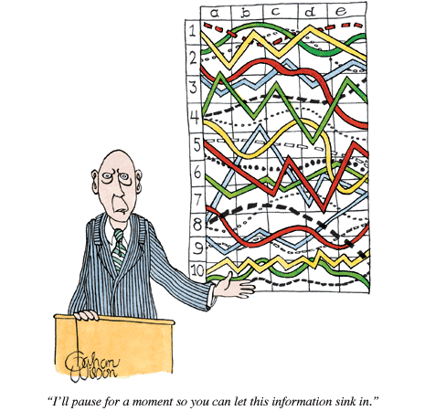
Everything You Wanted to Know about Statistics but Were Afraid to Ask
Andrew L. Luna, Ph.D

Slide 2
Contact information
Andrew L. Luna
Director
Institutional Research, Planning, and Assessment
The University of North Alabama
alluna@una.edu
Phone: 256.765.4221

Slide 3
Course outline
Section 1: Scientific Method, descriptive/inferential statistics, sampling, validity, and types of data.
Break
Section 2: Descriptive statistics, normal distribution, Central Limit Theorem, measures of central tendency, z scores, hypothesis testing.
Lunch
Section 3: Type I and Type II Error, Pearson R, Degrees of Freedom, Chi Square, t-test.
Break
Section 4: ANOVA and Regression

Slide 4
Connection?

Slide 5
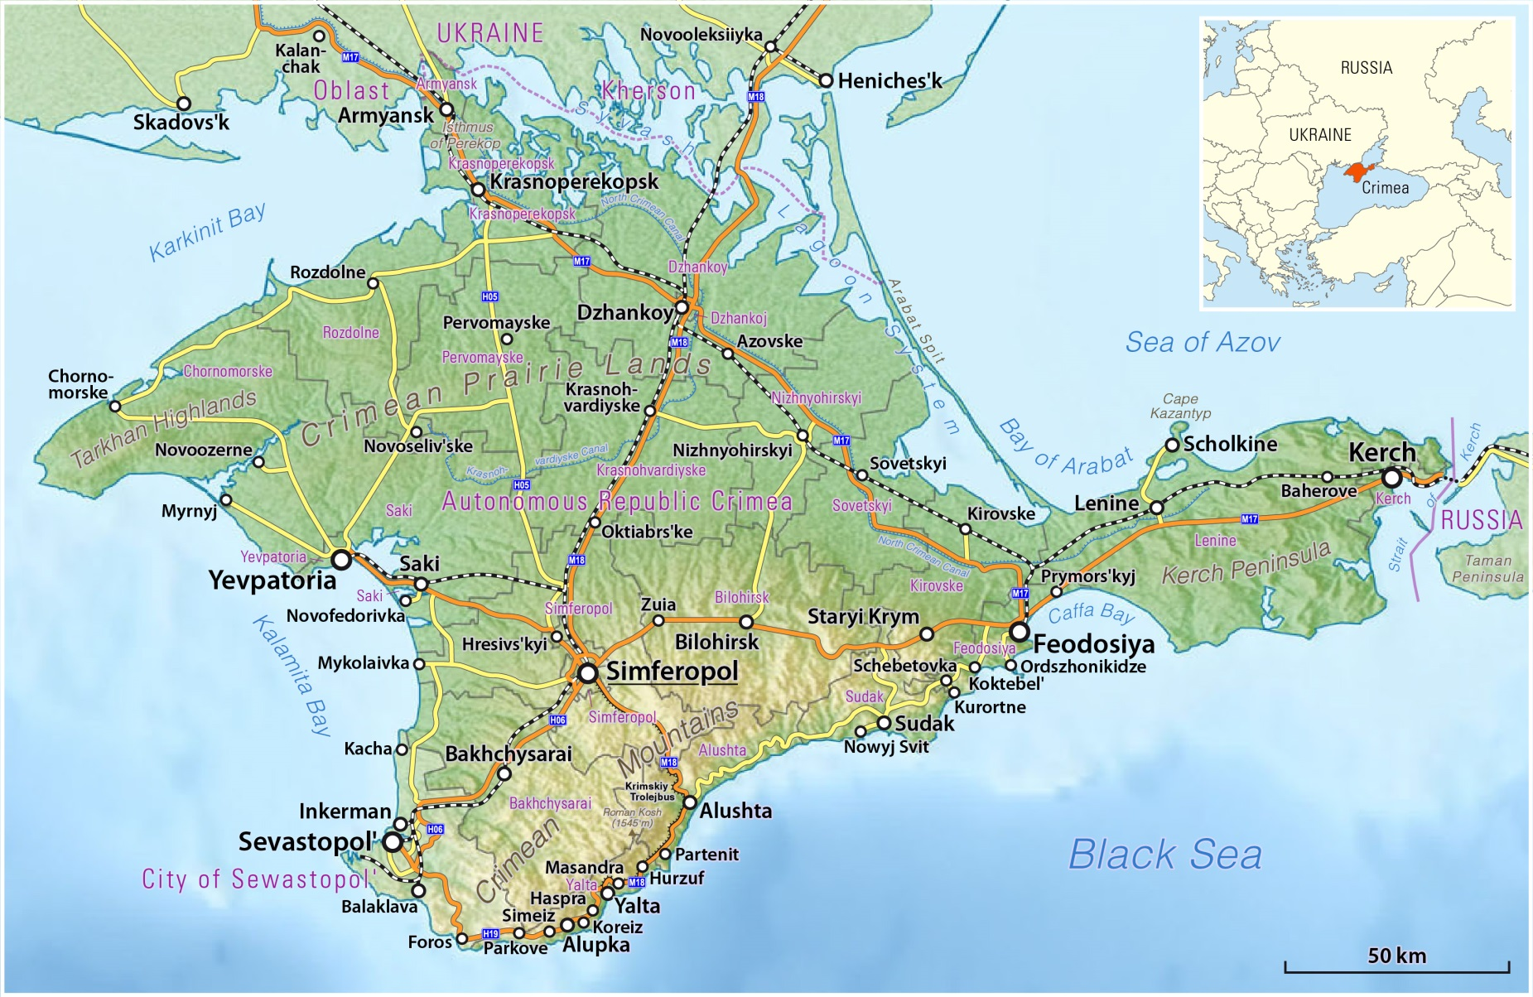

Slide 6
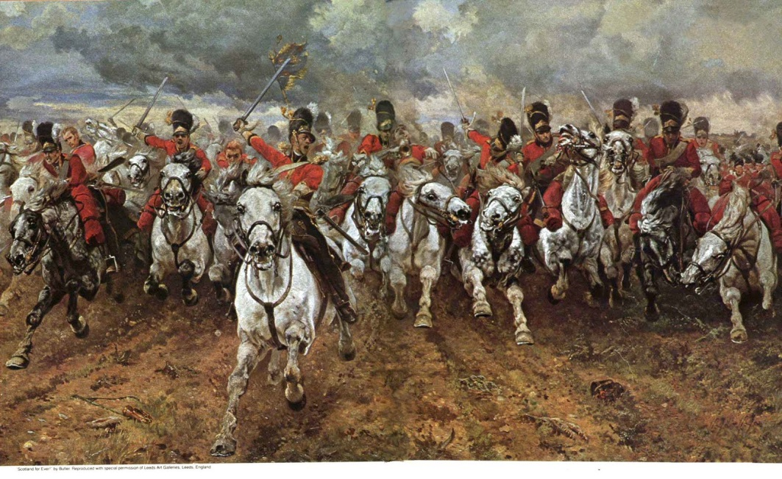
The Crimean War
The Crimean War (1853-1856) was a bloody battle between the Russians and the British Alliance (Great Brittan, France, Ottoman Empire, Kingdom of Sardinia) that saw great casualties on both sides.
“Half a league, half a league, Half a league onward, All in the valley of Death Rode the six hundred. "Forward, the Light Brigade! "Charge for the guns!" he said: Into the valley of Death Rode the six hundred…”
Alfred, Lord Tennyson, “The Charge of the Light Brigade.” Written to memorialize events in the Balaclava, Oct. 25, 1854.

Slide 7
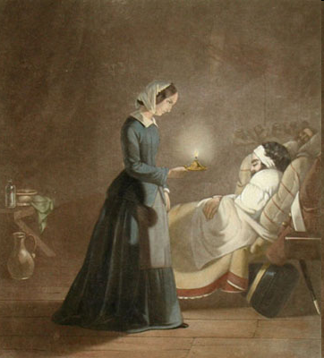
Florence Nightingale “Lady with the Lamp”
Florence Nightingale observed the horrific conditions of the wounded and was instrumental in convincing the British government to make sweeping changes in the sanitary conditions of the make-shift “hospitals.” Her work to make conditions more sanitary caused the mortality rate to decline from 44 percent to 2 percent within 6 months.
Nightingale wanted to create a visual representation of her argument on sanitary conditions in her reports to the British government. She saw that creating a circle denoting 100 percent of an event, and dividing that circle into segments, she could produce a simple graph that contained a lot of information…thus, Florence Nightingale created the PIE CHART!
Florence Nightingale (1820-1910)
Lo! in that hour of misery A lady with a lamp I see Pass through the glimmering gloom, And flit from room to room.
Henry Wadsworth Longfellow’s 1857 poem “Santa Filomena”

Slide 8
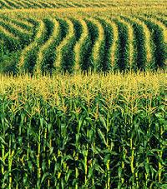
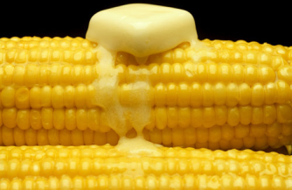
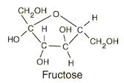
Knowledge, Data, Information, and Decisions…
Data
Knowledge
Information
New Knowledge/Decisions

Slide 9
The Scientific Method
Scientific Method
The way researchers go about using knowledge and evidence to reach objective conclusions about the real world.
The analysis and interpretation of empirical evidence (facts from observation or experimentation) to confirm or disprove prior conceptions

Slide 10
Characteristics of the scientific method
Scientific Research is Public – Advances in science require freely available information (replication/peer scrutiny)
Science is Objective – Science tries to rule out eccentricities of judgment by researchers and institutions. Wilhelm von Humboldt (1767-1835), founder University of Berlin (teaching, learning, research) “Lehrfreiheit,” “Lernfreiheit,” and “Freiheit der Wissenschaft”
Science is Empirical – Researchers are concerned with a world that is knowable and potentially measurable. Researchers must be able to perceive and classify what they study and reject metaphysical and nonsensical explanations of events.

Slide 11
Characteristics of the scientific method, cont.
Science is Systematic and Cumulative – No single research study stands alone, nor does it rise or fall by itself. Research also follows a specific method.
Theory – A set of related propositions that presents a systematic view of phenomena by specifying relationsships among concepts
Law – is a statement of fact meant to explain, in concise terms, an action or set of actions that is generally accepted to be true and universal
Science is Predictive – Science is concerned with relating the present to the future (making predictions)
Science is Self-Correcting – Changes in thoughts, theories, or laws are appropriate wen errors in previous research are uncovered

Slide 12
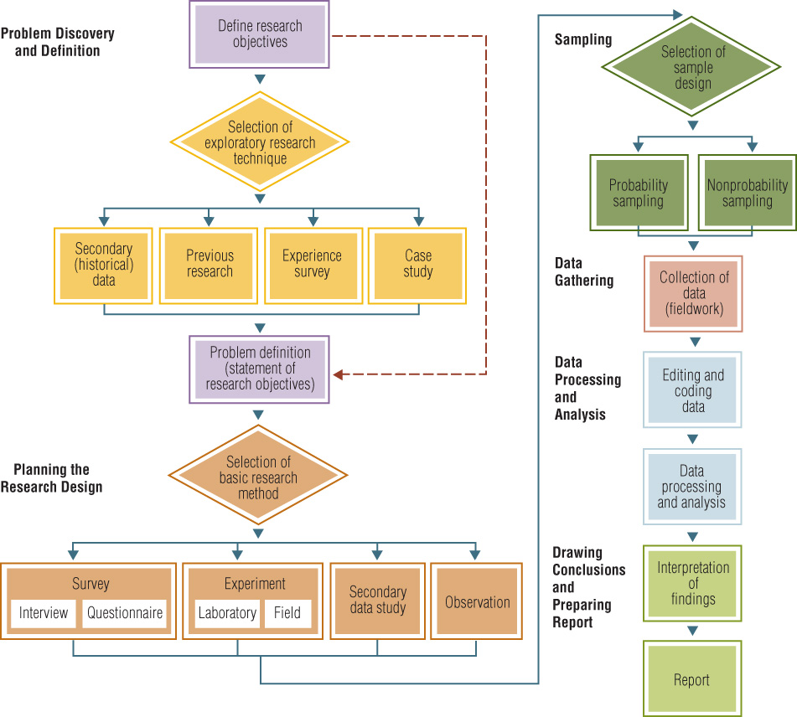
Flow chart of the scientific method
Note: Diamond-shaped boxes indicate stages in the research process in which a choice of one or more techniques must be made. The dotted line indicates an alternative path that skips exploratory research.

Slide 13
Two basic types of research
Qualitative Research (words) - is by definition exploratory, and it is used when we don’t know what to expect, to define the problem or develop an approach to the problem. It’s also used to go deeper into issues of interest and explore nuances related to the problem at hand. Common data collection methods used in qualitative research are focus groups, in-depth interviews, uninterrupted observation, bulletin boards, and ethnographic participation/observation.
Quantitative Research (numbers) - is conclusive in its purpose as it tries to quantify the problem and understand how prevalent it is by looking for projectable results to a larger population. Here we collect data through surveys (online, phone, paper), audits, points of purchase (purchase transactions), and other trend data.

Slide 14
Stating a hypothesis or research question
Research Question – A formally stated question intended to provide indications about some; it is not limited to investigating relationships between variables. Used when the researcher is unsure about the nature of the problem under investigation.
Hypothesis – a formal statement regarding the relationship between variables and is tested directly. The predicted relationship between the variables is either true or false.
Independent Variable (X_{i})– the variable that is systematically varied by the researcher
Dependent Variable (Y_{i}) – the variable that is observed and whose value is presumed to depend on independent variables

Slide 15
Hypothesis vs. research question
Research Question: “Does television content enrich a child’s imaginative capacities by offering materials and ideas for make-believe play?
Hypothesis: The amount of time a child spends in make-believe play is directly related to the amount of time spent viewing make-believe play on television.
Null Hypothesis: the denial or negation of a research hypothesis; the hypothesis of no difference
H_{O}: “There is no significant difference between the amount of time children engage in make-believe play and the amount of time children watch make-believe play on television.”

Slide 16
Data analysis and interpretation
Every research study must be carefully planed and performed according to specific guidelines.
When the analysis is completed, the researcher must step back and consider what has been discovered.
The researcher must ask two questions:
Are the results internally and externally valid?
Are the results valid
Neither Valid
nor Reliable
Valid but
not Reliable
Not Valid
but Reliable
Both Valid
and Reliable

Slide 17
Internal validity
If y = f(x), control over the research conditions is necessary to eliminate the possibility of finding that y = f(b), where b is an extraneous variable.
Artifact – Any variable that creates a possible but incorrect explanation of results. Also referred to as a confounding variable.
The presence of an artifact indicates issues of internal validity; that is, the study has failed to investigate its hypothesis

Slide 18
What affects Internal validity
History – various events that occur during a study may affect the subject’s attitudes, opinions, and behavior.
Maturation – Subjects’ biological and psychological characteristics change during the course of a study (mainly longitudinal).
Testing – The act of testing may cause artifacts depending on the environment, giving similar pre-tests/post-tests, and/or timing.
Instrumentation – A situation where equipment malfunctions, observers become tired/casual, and/or interviewers may make mistakes.
Statistical regression – Subjects who achieve either very high or very low scores on a test tend to regress to (move toward) the sample or population mean.

Slide 19
What affects internal validity, cont.
Experimental Mortality – All research studies face the possibility that subjects will drop out for one reason or another.
Sample Selection – When groups are not selected randomly or when they are not homogeneous
Demand Characteristics – Subjects’ reactions to experimental situations. Subjects who recognize the purpose of a study may produce only “good” data for researchers (Hawthorne Effect).
Experimenter Bias – Researcher becomes swayed by a client’s (or personal) wishes for a project’s results (Blind vs. Double Blind).
Evaluation Apprehension – Subjects are afraid of being measured or tested.
Causal Time Order – An experiment’s results are due not to the stimulus (independent) variable but rather to the effect of the dependent variable.

Slide 20
What affects internal validity, cont.
Diffusion or Imitation of Treatments – Where respondents may have the opportunity to discuss the experiment/study with another respondent who hasn’t yet participated.
Compensation – The researcher treats the control group differently because of the belief that the group has been “deprived.”
Compensatory Rivalry – Subjects who know they are in the control group may work harder to perform differently or outperform the experimental group.
Demoralization – Control group may feel demoralized or angry that they are not in the experiential group.

Slide 21
External validity
How well the results or a study can be generalized across the population.
Use random samples.
Us heterogeneous (diverse) samples and replicate the study several times.
Select a sample that is representative of the group to which the results will be generalized.

Slide 22
Sample Population

Slide 23
Probability versus Nonprobability Sampling
Probability Sampling
A sampling technique in which every member of the population has a known, nonzero probability of selection.
Nonprobability Sampling
A sampling technique in which units of the sample are selected on the basis of personal judgment or convenience.
The probability of any particular member of the population being chosen is unknown.

Slide 24
Replication
Replication - the independent verification of a study and is designed to eliminate:
Design-specific results
Sample-specific results
Method-specific results
Literal Replication – Involves the exact duplication of a previous study
Operational Replication – attempts to duplicate only the sampling and experimental procedures of a previous study
Instrumental replications – Attempts to duplicate the dependent measures used in a previous study.
Constructive Replication – Attempts to test the validity of a previous study by not imitating the previous study.

Slide 25
concepts
Building Blocks of Theory
Abstract
Represents broad, general ideas
Not directly observable
Examples:
Reality
Ideology
Commercialism
Value
Aesthetics

Slide 26
Theory
Systematic; abstract explanation of some aspect of reality
Primary goal is to provide a framework that links research and practice and contributes to making findings meaningful and generalizable
Structure for interpretation of findings
Means for summarizing and explaining observations for an isolated study
Source to generate hypothesis
Framework for guiding research
Guide for selecting appropriate method
Basis to describe, explain or predict factors influencing outcomes

Slide 27
constructs
Concepts that are specified in such away they are observable in the real world
Invented
Examples
(Reality) Opinion, Choice
(Ideology) Conservatism, Liberalism, Libertarianism, Socialism
(Commercialism) Profit, Ratings
(Value) amount of information , newsworthiness, time spent
(Aesthetics) Color, Layout, Sound, Composition

Slide 28
Variables
Concepts that are observable and measurable
Have a dimension that can vary
Narrow in meaning
Examples:
Color classification
Loudness
Level of satisfaction/agreement
Amount of time spent
Media choice

Slide 29
Types and forms of variables
Variable Types:
Independent – those that are systematically varied by the researcher
Dependent – those that are observed. Their values are resumed to depend on the effects of the independent variables
Variable Forms:
Discrete – only includes a finite set of values (yes/no; republican/democrat; satisfied….not satisfied, etc.)
Continuous – takes on any value on a continuous scale (height, weight, length, time, etc.)

Slide 30
Scales: Concept
A generalized idea about a class of objects, attributes, occurrences, or processes
Example: Satisfaction

Slide 31
Scales: Operational Definition
Specifies what the researcher must do to measure the concept under investigation
Example: A 1-7 scale measuring the level of satisfaction; A measure of number of hours watching TV.

Slide 32
Media skepticism: conceptual definition
Media skepticism - the degree to which individuals are skeptical toward the reality presented in the mass media. Media skepticism varies across individuals, from those who are mildly skeptical and accept most of what they see and hear in the media to those who completely discount and disbelieve the facts, values, and portrayal of reality in the media.

Slide 33
Media skepticism: operational definition
Please tell me how true each statement is about the news story. Is it very true, not very true, or not at all true?
1. The program was not accurate in its portrayal of the problem.
2. Most of the story was staged for entertainment purposes.
3. The presentation was slanted and unfair.
I believe national network news is fair in its portrayal of national news stories:
Strongly Disagree Disagree Neutral Agree Strongly Agree

Slide 34
Numbers, numbers everywhere
555-867-5309
9001
9
3.5
.05
97.5
502
4,832
834,722
77
999
.998
65.87
36²
4001
.56732
51
1,248,965
2,387
9
21
672
145
999-99-9999
324
409
35.5

Slide 35
Scales
Represents a composite measure of a variable
Series of items arranged according to value for the purpose of quantification
Provides a range of values that correspond to different characteristics or amounts of a characteristic exhibited in observing a concept.
Scales come in four different levels: Nominal, Ordinal, Interval, and Ratio

Slide 36
Nominal Scale
Indicates a difference

Slide 37
Ordinal Scale
Indicates a difference
Indicates the direction of the distance (e.g. more than or less than)

Slide 38
Interval Scale
Indicates a difference
Indicates the direction of the distance (e.g. more than or less than)
Indicates the amount of the difference (in equal intervals)
32 f
0 c

Slide 39
Ratio Scale
Indicates a difference
Indicates the direction of the distance (e.g. more than or less than)
Indicates the amount of the difference (in equal intervals)
Indicates an absolute zero

Slide 40
Discussion/Test: Identify the Scale
Sammy Sosa # 21
Prices on the Stock Market
Gender: Male = 1 or Female = 2
Professorial rank: Asst. = 1, Assoc. = 2, Full = 3
Number of Newspapers sold each day
Amount of time a subject watches a television program
Arbitron Rating
Salary
Satisfaction on a 1-7 Likert Scale
How many times respondents return to a website
Decibel level of a speaker
Weight of paper

Slide 41
Things are not always what they seem to be…
Radio Stations
Does it show a difference?
Does it show the direction of difference?
Is the difference measured in equal intervals?
Does the measure have an absolute zero?

Slide 42
Operational definitions: classroom project
Provide operational definitions for the following:
Artistic quality
Objectionable song lyrics
Writing quality
Sexual content
Critical Thinking

Slide 43
Break
Return at 10:00 a.m

Slide 44
Two sets of scores…
Group 1
Group 2
100, 100
99, 98
88, 77
72, 68
67, 52
43, 42
91, 85
81, 79
78, 77
73, 75
72, 70
65, 60
How can we analyze these numbers?

Slide 45
Choosing one of the groups… Descriptive statistics
Frequency Distribution
Frequency Distribution
Grouped in Intervals
Distribution of Responses
Scores | Frequency (N = 12)
100 | 2
99 | 1
98 | 1
88 | 1
77 | 1
72 | 1
68 | 1
67 | 1
52 | 1
43 | 1
42 | 1
100, 100
99, 98
88, 77
72, 68
67, 52
43, 42
Scores | Frequency (N = 12)
40 - 59 | 3
60 - 79 | 4
80 - 100 | 5

Slide 46
Scores | Frequency | Percentage | Cumulative Frequency | Cumulative Percentage
100 | 2 | 8.33% | 2 | 8.33%
99 | 1 | 4.17% | 3 | 12.50%
98 | 1 | 4.17% | 4 | 16.67%
91 | 1 | 4.17% | 5 | 20.83%
88 | 1 | 4.17% | 6 | 25.00%
85 | 1 | 4.17% | 7 | 29.17%
81 | 1 | 4.17% | 8 | 33.33%
79 | 1 | 4.17% | 9 | 37.50%
78 | 1 | 4.17% | 10 | 41.67%
77 | 2 | 8.33% | 12 | 50.00%
75 | 1 | 4.17% | 13 | 54.17%
73 | 1 | 4.17% | 14 | 58.33%
72 | 2 | 8.33% | 16 | 66.67%
70 | 1 | 4.17% | 17 | 70.83%
68 | 1 | 4.17% | 18 | 75.00%
67 | 1 | 4.17% | 19 | 79.17%
65 | 1 | 4.17% | 20 | 83.33%
60 | 1 | 4.17% | 21 | 87.50%
52 | 1 | 4.17% | 22 | 91.67%
43 | 1 | 4.17% | 21 | 87.50%
42 | 1 | 4.17% | 24 | 100.00%
N = | 24 | 100.00%
Frequency Distribution with Columns for Percentage, Cumulative Frequency, and Cumulative Percentage

Slide 47
Creating a histogram (bar chart)

Slide 48
Creating a Frequency polygon

Slide 49
Normal Distribution
68%
95%
95%
99%
99%

Slide 50
The Bell Curve
.01
.01
Significant
Significant
Mean=70

Slide 51
Central limit theorem
In probability theory, the central limit theorem says that, under certain conditions, the sum of many independent identically-distributed random variables, when scaled appropriately, converges in distribution to a standard normal distribution.

Slide 52
Central Tendency
These statistics answer the question: What is a typical score?
The statistics provide information about the grouping of the numbers in a distribution by giving a single number that characterizes the entire distribution.
Exactly what constitutes a “typical” score depends on the level of measurement and how the data will be used.
For every distribution, three characteristic numbers can be identified:
Mode
Median
Mean

Slide 53
Measures of Central Tendency
Mean - arithmetic average
µ, Population; x , sample
Median - midpoint of the distribution
Mode - the value that occurs most often

Slide 54
Mode Example
Find the score that occurs most frequently
98
88
81
74
72
72
70
69
65
52
Mode = 72

Slide 55
Median Example
Arrange in descending order and find the midpoint
Odd Number (N = 9)
Even Number (N = 10)
98
88
81
74
72
70
69
65
52
98
88
81
74
72
71
70
69
65
52
Midpoint = 72
Midpoint =
(72+71)/2
= 71.5

Slide 56
Different means
Arithmetic Mean - the sum of all of the list divided by the number of items in the list

Slide 57
Arithmetic Mean Example
98
88
81
74
72
72
70
69
65
52
741\10 = 74.1
741

Slide 58
Normal Distribution
68%
95%
95%
99%
99%

Slide 59
Frequency polygon of test score data

Slide 60
Skewness
Refers to the concentration of scores around a particular point on the x-axis.
If this concentration lies toward the low end of the scale, with the tail of the curve trailing off to the right, the curve is called a right skew.
If the tail of the curve trails off to the left, it is a left skew.

Slide 61
Skewness
Skewness can occur when the frequency of just one score is clustered away from the mean.

Slide 62
Normal Distribution
68%
95%
95%
99%
99%
Mode = Median = Mean

Slide 63
When the Distribution may not be normal
Mode = 45K

Slide 64
Measures of Dispersion or Spread
Range
Variance
Standard deviation

Slide 65
The Range as a Measure of Spread
The range is the distance between the smallest and the largest value in the set.
Range = largest value – smallest value
Group 1
Group 2
100, 100
99, 98
88, 77
72, 68
67, 52
43, 42
91, 85
81, 79
78, 77
73, 75
72, 70
65, 60
Range G1: 100 – 42 = 58
Range G2: 91 – 60 = 31

Slide 66
population Variance

Slide 67
Sample Variance

Slide 68
Variance
A method of describing variation in a set of scores
The higher the variance, the greater the variability and/or spread of scores

Slide 69
Variance Example
X
X
X - X
X –X²
98
88
81
74
72
72
70
69
65
52
74.1 =
74.1 =
74.1 =
74.1 =
74.1 =
74.1 =
74.1 =
74.1 =
74.1 =
74.1 =
23.90 = 571.21
13.90 = 193.21
6.90 = 47.61
-0.10 = 0.01
-2.10 = 4.41
-2.10 = 4.41
-4.10 = 16.81
-5.10 = 26.01
-9.10 = 82.81
-22.10 = 488.41
Population Variance (N)
1,434.90 \ 10 = 143.49
Sample Variance (n-1)
1,434.90 \ 9 = 159.43
Mean = 74.1
1,434.90

Slide 70
Uses of the variance
The variance is used in many higher-order calculations including:
T-test
Analysis of Variance (ANOVA)
Regression
A variance value of zero indicates that all values within a set of numbers are identical
All variances that are non-zero will be positive numbers. A large variance indicates that numbers in the set are far from the mean and each other, while a small variance indicates the opposite.

Slide 71
Standard Deviation
Another method of describing variation in a set of scores
The higher the standard deviation, the greater the variability and/or spread of scores

Slide 72
Sample Standard Deviation

Slide 73
Standard Deviation Example
Population STD
X
X
X - X
X –X²
1,434.90 \ 10 = 143.49
98
88
81
74
72
72
70
69
65
52
74.1 =
74.1 =
74.1 =
74.1 =
74.1 =
74.1 =
74.1 =
74.1 =
74.1 =
74.1 =
23.90 = 571.21
13.90 = 193.21
6.90 = 47.61
-0.10 = 0.01
-2.10 = 4.41
-2.10 = 4.41
-4.10 = 16.81
-5.10 = 26.01
-9.10 = 82.81
-22.10 = 488.41
(SQRT) 143.49 = 11.98
Sample STD
1,434.90 \ 9 = 159.43
(SQRT) 159.43 = 12.63
Mean = 74.1
1,434.90

Slide 74
Class assignment
A survey was given to UNA students to find out how many hours per week they would listen to a student-run radio station. The sample responses were separated by gender. Determine the mean, range, variance, and standard deviation of each group.
Group A (Female)
15
25
12
7
3
32
17
16
9
24
Group B (Male)
30
15
21
12
26
20
5
24
18
10

Slide 75
Group one (females)
X | Mean | X-Mean | X-Mean²
15 | 16 | -1 | 1
25 | 16 | 9 | 81
12 | 16 | -4 | 16
7 | 16 | -9 | 81
3 | 16 | -13 | 169 |  | 718/9 | 79.78
32 | 16 | 16 | 256
17 | 16 | 1 | 1 |  | SQRT | 8.93
16 | 16 | 0 | 0
9 | 16 | -7 | 49
24 | 16 | 8 | 64
16 |  |  | 718
Range = 29

Slide 76
Group Two (Males)
X | Mean | X-Mean | X-Mean²
30 | 18 | 12 | 144
15 | 18 | -3 | 9
21 | 18 | 3 | 9
12 | 18 | -6 | 36
26 | 18 | 8 | 64
20 | 18 | 2 | 4 |  | 535/9 | 59.44
5 | 18 | -13 | 169
24 | 18 | 6 | 36 |  | SQRT | 7.71
18 | 18 | 0 | 0
10 | 18 | -8 | 64
18 |  |  | 535
Range = 22

Slide 77
Results
Radio Listening Results
Group | Average | Range | Variance | S
Females | 16 | 29 | 79.78 | 8.93
Males | 18 | 22 | 59.44 | 7.71

Slide 78
Standard Deviation on Bell Curve
.01
.01
What if S = 4?
Significant
Significant
58
62
66
Mean=70
74
78
82
-3
-2
-1
0
1
2
3

Slide 79
How Variability and Standard Deviation Work…
Class A
Class B
100, 100
99, 98
88, 77
72, 68
67, 52
43, 42
91, 85
81, 79
78, 77
73, 75
72, 70
65, 60
Mean
Mean = 75.5
Mean = 75.5
STD = 21.93
STD = 8.42

Slide 80
How Do We Use This Stuff?
The type of data determines what kind of measures you can use
Higher order data can be used with higher order statistics

Slide 81
When scores don’t compare
A student takes the ACT test (11-36) and scores a 22…
The same student takes the SAT (590-1,600) and scores a 750…
The same student takes the TOFFEL (0-120) and scores a 92…
How can we tell if the student did better/worse on one score in relation to the other scores?
ANSWER: Standardize or Normalize the scores
HOW: Z-Scores!

Slide 82
Z-Scores
In statistics, the standard score is the (signed) number of standard deviations an observation or datum is above or below the mean.
A positive standard score represents a datum above the mean, while a negative standard score represents a datum below the mean.
It is a dimensionless quantity obtained by subtracting the population mean from an individual raw score and then dividing the difference by the population standard deviation. This conversion process is called standardizing or normalizing.
Standard scores are also called z-values, z-scores, normal scores, and standardized variables.

Slide 83
Z-score formula
$$z= \frac{X−\overline{X}}{S}$$
Z-Scores with positive numbers are above the mean while Z-Scores with negative numbers are below the mean.

Slide 84
Z-scores, cont.
It is a little awkward in discussing a score or observation to have to say that it is “2 standard deviations above the mean” or “1.5 standard deviations below the mean.”
To make it a little easier to pinpoint the location of a score in any distribution, the z-score was developed.
The z-score is simply a way of telling how far a score is from the mean in standard deviation units.

Slide 85
Calculating the z-score
If the observed value (individual score) = 9; the mean = 6; and the standard deviation = 2.68:
$z= \frac{x−\overline{x}}{S}=\frac{9−6}{2.68}= \frac{3}{2.68}=1.12$

Slide 86
Z-Scores, cont.
A z-score may also be used to find the location of a score that is a normally distributed variable.
Using an example of a population of IQ test scores where the individual score = 80; population mean = 100; and the population standard deviation = 16…
$$z= \frac{X−μ}{∂}=\frac{80−100}{16}=\frac{−20}{16}=−1.25$$

Slide 87
Comparing z-scores
Z-scores allow the researcher to make comparisons between different distributions.
Mathematics | Natural Science | English
µ = 75 | µ = 103 | µ = 52
σ = 6 | σ = 14 | σ = 4
X = 78 | X = 115 | X = 57
Mathematics
$$z=\frac{X−μ}{σ}=\frac{78−75}{6}=\frac{3}{6}=0.5$$
Natural Science
$$z=\frac{115−103}{14}=\frac{12}{14}=0.86$$
English
$$z=\frac{57−52}{4}=\frac{5}{4}=1.25$$

Slide 88
Area under the normal curve
50%
50%
34.1%
34.1%
13.5%
13.5%
2.2%
2.2%
68.2%
95.2%
99.6%

Slide 89
Area under the normal curve
TV viewing is normally distributed with a mean of 2 hours per day and standard deviation of .05. What proportion of the population watches between 2 and 2.5 hours of TV?
50%
50%
34.1%
34.1%
13.5%
13.5%
2.2%
2.2%
0
1
$$\frac{2−2}{.5}=0$$
$$\frac{2.5−2}{.5}=1$$
Answer = 34%

Slide 90
Area under the normal curve
How many watches more than 3 hours per day?
50%
50%
34.1%
34.1%
13.5%
13.5%
2.2%
2.2%
2
$$\frac{3−2}{.5}=2$$
Answer = 2.2%

Slide 91
Area under the normal curve
Go to z-score table on-line
Assume the z-score of a normally distributed variable is 1.79
First find the row with 1.7, then go to the column of .09 (second decimal place in z).
At the intersection of the 1.7 row and the .09 column is the number .4633.
Therefore, the area between the mean of the curve (midpoint) and a z-score of 1.79, is .4633 or approximately 46%

Slide 92
Final example
What is the distance from the midpoint of a curve to the z-score of -1.32?
Find the row 1.3
Then find the column .02
At the intersection of the row 1.3 and the column of .02 is .4066.
The distance from the midpoint of a curve to the z-score of -1.32 is 40.66%
No matter if the z-score is negative or positive, the area is always positive.

Slide 93
The normal curve
50%
50%
34.1%
34.1%
13.5%
13.5%
2.2%
2.2%

Slide 94
Interpretation
Interpretation
The process of drawing inferences from the analysis results.
Inferences drawn from interpretations lead to managerial implications and decisions.
From a management perspective, the qualitative meaning of the data and their managerial implications are an important aspect of the interpretation.

Slide 95
Inferential Statistics Provide Two Environments:
Test for Difference – To test whether a significant difference exists between groups
Tests for relationship – To test whether a significant relationship exist between a dependent (Y) and independent (X) variable/s
Relationship may also be predictive

Slide 96
Hypothesis Testing Using Basic Statistics
Univariate Statistical Analysis
Tests of hypotheses involving only one variable.
Bivariate Statistical Analysis
Tests of hypotheses involving two variables.
Multivariate Statistical Analysis
Statistical analysis involving three or more variables or sets of variables.

Slide 97
Hypothesis Testing Procedure
Process
The specifically stated hypothesis is derived from the research objectives.
A sample is obtained and the relevant variable is measured.
The measured sample value is compared to the value either stated explicitly or implied in the hypothesis.
If the value is consistent with the hypothesis, the hypothesis is supported.
If the value is not consistent with the hypothesis, the hypothesis is not supported.

Slide 98
Hypothesis Testing Procedure, Cont.
H₀ – Null Hypothesis
“There is no significant difference/relationship between groups”
H_{a} – Alternative Hypothesis
“There is a significant difference/relationship between groups”
Always state your Hypothesis/es in the Null form
The object of the research is to either reject or accept the Null Hypothesis/es

Slide 99
Significance Levels and p-values
Significance Level
A critical probability associated with a statistical hypothesis test that indicates how likely an inference supporting a difference between an observed value and some statistical expectation is true.
The acceptable level of Type I error.
p-value
Probability value, or the observed or computed significance level.
p-values are compared to significance levels to test hypotheses.

Slide 100
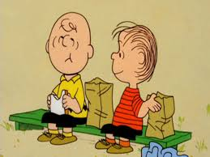
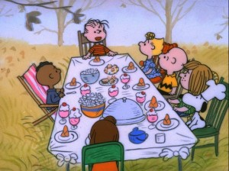
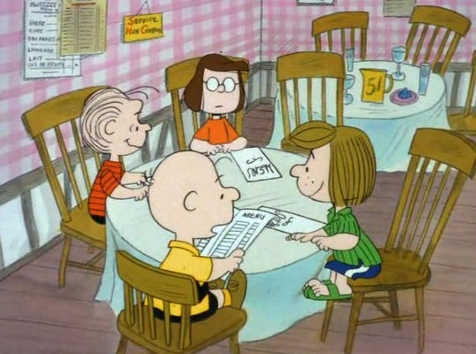
Lunch
Return at 1:00 p.m.

Slide 101
Experimental Research: What happens?
An hypothesis (educated guess) and then tested. Possible outcomes:
Something Not Will Happen
It Happens
Something Will Not Happen
It Does Not Happen
Something Will Happen
It Happens
Something Will Happen
It Does Not Happen

Slide 102
Type I and Type II Errors
Type I Error
An error caused by rejecting the null hypothesis when it should be accepted (false positive).
Has a probability of alpha (α).
Practically, a Type I error occurs when the researcher concludes that a relationship or difference exists in the population when in reality it does not exist.
“There really are no monsters under the bed.”

Slide 103
Type I and Type II Errors (cont’d)
Type II Error
An error caused by failing to reject the null hypothesis when the hypothesis should be rejected (false negative).
Has a probability of beta (β).
Practically, a Type II error occurs when a researcher concludes that no relationship or difference exists when in fact one does exist.
“There really are monsters under the bed.”

Slide 104
Type I and II Errors and Fire Alarms?
FIRE
NO FIRE
NO ALARM
TYPE I
NO ERROR
Alarm
NO ERROR
TYPE II
H₀ is
False
H₀ is True
ACCEPT H₀
TYPE I
NO ERROR
REJECT H₀
NO ERROR
TYPE II

Slide 105
Type I and Type II Errors - Sensitivity
Not Sensitive
Sensitive
TYPE I
TYPE II

Slide 106
Normal Distribution
.05
.05
.01
.01
68%
95%
95%
99%
99%

Slide 107
Recapitulation of the Research Process
Collect Data
Run Descriptive Statistics
Develop Null Hypothesis/es
Determine the Type of Data
Determine the Type of Test/s (based on type of data)
If test produces a significant p-value, REJECT the Null Hypothesis. If the test does not produce a significant p-value, ACCEPT the Null Hypothesis.
Remember that, due to error, statistical tests only support hypotheses and can NOT prove a phenomenon

Slide 108
Data Type v. Statistics Used
Data Type | Statistics Used
Nominal | Frequency, percentages, modes
Ordinal | Frequency, percentages, modes, median, range, percentile, ranking
Interval | Frequency, percentages, modes, median, range, percentile, ranking average, variance, SD, t-tests, ANOVAs, Pearson Rs, regression
Ratio | Frequency, percentages, modes, median, range, percentile, ranking average, variance, SD, t-tests, ratios, ANOVAs, Pearson Rs, regression

Slide 109
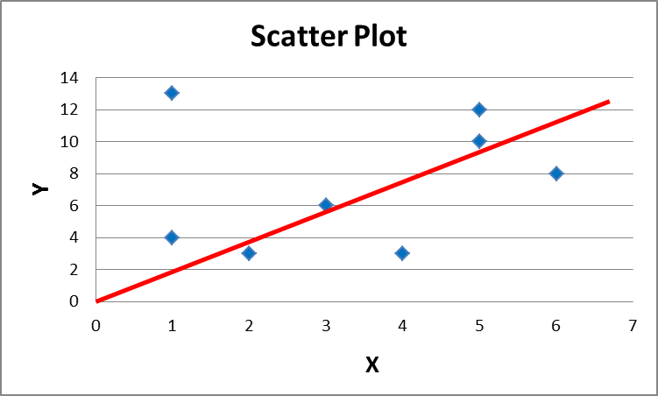
Pearson R Correlation Coefficient
X
1
3
5
5
1
2
4
6
Y
4
6
10
12
13
3
3
8

Slide 110
Pearson R Correlation Coefficient
A measure of how well a linear equation describes the relation between two variables X and Y measured on the same object
 | X | Y | $$x − \overline{x}$$ | y$−\overline{y}$ | xy | $$x^{2}$$ | $$y^{2}$$
 | 1 | 4 | -3 | -5 | 15 | 9 | 25
 | 3 | 6 | -1 | -3 | 3 | 1 | 9
 | 5 | 10 | 1 | 1 | 1 | 1 | 1
 | 5 | 12 | 1 | 3 | 3 | 1 | 9
 | 1 | 13 | 2 | 4 | 8 | 4 | 16
Total | 20 | 45 | 0 | 0 | 30 | 16 | 60
Mean | 4 | 9 | 0 | 0 | 6

Slide 111
Calculation of Pearson R
$$r= \frac{\sum{xy}}{\sqrt{\sum{x^{2}\sum{y^{2}}}}}$$
$r= \frac{30}{\sqrt{\left(16\right)\left(60\right)}}=\frac{30}{\sqrt{960}}=\frac{30}{30.984}=0.968$

Slide 112
Alternative Formula
$$r=\frac{\sum{xy−}\frac{\sum{x\sum{y}}}{N}}{\sqrt{\sum{x^{2}−\frac{{\left(\sum{x}\right)}^{2}}{N}\sqrt{\sum{Y^{2}−\frac{{\left(\sum{Y}\right)}^{2}}{N}}}}}}$$

Slide 113
How Can R’s Be Used?
Y
Y
Y
R = 1.00
R = .18
R = .85
X
X
X
Y
R’s of 1.00 or -1.00 are perfect correlations
The closer R comes to 1, the more related the
X and Y scores are to each other
R-Squared is an important statistic that indicates
the variance of Y that is attributed to by the
variance of X (.04, .73)
R = -.92
X

Slide 114
Concept of degrees of freedom
Choosing Classes for Academic Program
Class I
Class D
Class M
Class G
Class L
Class A
Class F
Class J
Class B
Class P
Class N
Class K
Class H
Class C
Class E
Class O
16 Classes to Graduate

Slide 115
Degrees of Freedom
The number of values in a study that are free to vary.
A data set contains a number of observations, say, n. They constitute n individual pieces of information. These pieces of information can be used either to estimate parameters or variability. In general, each item being estimated costs one degree of freedom. The remaining degrees of freedom are used to estimate variability. All we have to do is count properly.
A single sample: There are n observations. There's one parameter (the mean) that needs to be estimated. That leaves n-1 degrees of freedom for estimating variability.
Two samples: There are n₁+n₂ observations. There are two means to be estimated. That leaves n₁+n₂-2 degrees of freedom for estimating variability.

Slide 116
Testing for Significant Difference
Testing for significant difference is a type of inferential statistic
One may test difference based on any type of data
Determining what type of test to use is based on what type of data are to be tested.

Slide 117
Testing Difference
Testing difference of gender to favorite form of media
Gender: M or F
Media: Newspaper, Radio, TV, Internet
Data: Nominal
Test: Chi Square
Testing difference of gender to answers on a Likert scale
Gender: M or F
Likert Scale: 1, 2, 3, 4, 5
Data: Interval
Test: t-test

Slide 118
What is a Null Hypothesis?
A type of hypothesis used in statistics that proposes that no statistical significance exists in a set of given observations.
The null hypothesis attempts to show that no variation exists between variables, or that a single variable is no different than zero.
It is presumed to be true until statistical evidence nullifies it for an alternative hypothesis.

Slide 119
Examples
Example 1: Three unrelated groups of people choose what they believe to be the best color scheme for a given website.
The null hypothesis is: There is no difference between color scheme choice and type of group
Example 2: Males and Females rate their level of satisfaction to a magazine using a 1-5 scale
The null hypothesis is: There is no difference between satisfaction level and gender

Slide 120
Chi Square
A chi square (X²) statistic is used to investigate whether distributions of categorical (i.e. nominal/ordinal) variables differ from one another.

Slide 121
General Notation for a chi square 2x2 Contingency Table
Variable 1
Variable 2 | Data Type 1 | Data Type 2 | Totals
Category 1 | a | b | a+b
Category 2 | c | d | c+d
Total | a+c | b+d | a+b+c+d
$$x^{2}=\frac{{\left(ad−bc\right)}^{2}\left(a+b+c+d\right)}{\left(a+b\right)\left(c+d\right)\left(b+d\right)\left(a+c\right)}$$

Slide 122
Chi square Steps
Collect observed frequency data
Calculate expected frequency data
Determine Degrees of Freedom
Calculate the chi square
If the chi square statistic exceeds the probability or table value (based upon a p-value of x and n degrees of freedom) the null hypothesis should be rejected.

Slide 123
Two questions from a questionnaire…
Do you like the television program? (Yes or No)
What is your gender? (Male or Female)

Slide 124
Gender and Choice Preference
H₀: There is no difference between gender and choice
Actual Data
 | Male | Female | Total
Like | 36 | 14 | 50
Dislike | 30 | 25 | 55
Total | 66 | 39 | 105
Row Total
Column Total
Grand Total
To find the expected frequencies, assume independence of the rows and columns. Multiply the row total to the column total and divide by grand total

Slide 125
Chi square
Expected Frequencies
 | Male | Female | Total
Like | 31.43 | 18.58 | 50.01
Dislike | 34.58 | 20.43 | 55.01
Total | 66.01 | 39.01 | 105.02
The number of degrees of freedom is calculated for an x-by-y table as (x-1) (y-1), so in this case (2-1) (2-1) = 1*1 = 1. The degrees of freedom is 1.

Slide 126
Chi square Calculations
O | E | O-E | (O-E)²/E
36 | 31.43 | 4.57 | .67
14 | 18.58 | -4.58 | 1.13
30 | 34.58 | -4.58 | .61
25 | 20.43 | 4.57 | 1.03
Chi square observed statistic = 3.44

Slide 127
Chi square
Probability Level (alpha)
Df | 0.5 | 0.10 | 0.05 | 0.02 | 0.01 | 0.001
1 | 0.455 | 2.706 | 3.841 | 5.412 | 6.635 | 10.827
2 | 1.386 | 4.605 | 5.991 | 7.824 | 9.210 | 13.815
3 | 2.366 | 6.251 | 7.815 | 9.837 | 11.345 | 16.268
4 | 3.357 | 7.779 | 9.488 | 11.668 | 13.277 | 18.465
5 | 4.351 | 9.236 | 11.070 | 13.388 | 15.086 | 20.51
Chi Square (Observed statistic) = 3.44
Probability Level (df=1 and .05) = 3.841 (Table Value)
So, Chi Square statistic < Probability Level (Table Value)
Accept Null Hypothesis
Check Critical Value Table for Chi Square Distribution on Page 448 of text

Slide 128
Results of Chi square Test
There is no significant difference between product choice and gender.

Slide 129
Chi square Test for Independence
Involves observations greater than 2x2
Same process for the Chi square test
Indicates independence or dependence of three or more variables…but that is all it tells

Slide 130
Two Questions…
What is your favorite color scheme for the website? (Blue, Red, or Green)
There are three groups (Rock music, Country music, jazz music)

Slide 131
Chi Square
H₀: Group is independent of color choice
Actual Data
Row
Total
 | Blue | Red | Green | Total
Rock | 11 | 6 | 4 | 21
Jazz | 12 | 7 | 7 | 26
Country | 7 | 7 | 14 | 28
Total | 30 | 20 | 25 | 75
Column Total
Grand
Total
To find the expected frequencies, assume independence of the rows and columns. Multiply the row total to the column total and divide by grand total

Slide 132
Chi Square
Expected Frequencies
 | Blue | Red | Green | Total
Rock | 8.4 | 5.6 | 7.0 | 21
Jazz | 10.4 | 6.9 | 8.7 | 26
Country | 11.2 | 7.5 | 9.3 | 28
Total | 30 | 20 | 25 | 75
The number of degrees of freedom is calculated for an x-by-y table as (x-1) (y-1), so in this case (3-1) (3-1) = 2*2 = 4. The degrees of freedom is 4.

Slide 133
Chi Square Calculations
O | E | O-E | (O-E)²/E
11 | 8.4 | 2.6 | .805
6 | 5.6 | .4 | .029
4 | 7 | 3 | 1.286
12 | 10.4 | 1.6 | .246
7 | 6.9 | .1 | .001
7 | 8.7 | 1.7 | .332
7 | 11.2 | 4.2 | 1.575
7 | 7.5 | .5 | .033
14 | 9.3 | 4.7 | 2.375
Chi Square observed statistic = 6.682

Slide 134
Chi Square Calculations, cont.
Probability Level (alpha)
Df | 0.5 | 0.10 | 0.05 | 0.02 | 0.01 | 0.001
1 | 0.455 | 2.706 | 3.841 | 5.412 | 6.635 | 10.827
2 | 1.386 | 4.605 | 5.991 | 7.824 | 9.210 | 13.815
3 | 2.366 | 6.251 | 7.815 | 9.837 | 11.345 | 16.268
4 | 3.357 | 7.779 | 9.488 | 11.668 | 13.277 | 18.465
5 | 4.351 | 9.236 | 11.070 | 13.388 | 15.086 | 20.51
Chi Square (Observed statistic) = 6.682
Probability Level (df=4 and .05) = 9.488 (Table Value)
So, Chi Square observed statistic < Probability level (table value)
Accept Null Hypothesis
Check Critical Value Table for Chi Square Distribution on page 448 of text

Slide 135
Chi square Test Results
There is no significant difference between group and choice, therefore, group and choice are independent of each other.

Slide 136
What’s the Connection?

Slide 137
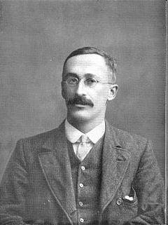
Gosset, Beer, and Statistics…
William S. Gosset (1876-1937) was a famous statistician who worked for Guiness. He was a friend and colleague of Karl Pearson and the two wrote many statistical papers together. Statistics, during that time involved very large samples, and Gosset needed something to test difference between smaller samples.
Gosset discovered a new statistic and wanted to write about it. However, Guiness had a bad experience with publishing when another academic article caused the beer company to lose some trade secrets.
Because Gosset knew this statistic would be helpful to all, he published it under the pseudonym of “Student.”
William Gosset

Slide 138
The t test
Mean for group 1
Mean for group 2
Pooled, or combined, standard error of difference between means
The pooled estimate of the standard error is a better estimate of the standard error than one based of independent samples.

Slide 139
Uses of the t test
Assesses whether the mean of a group of scores is statistically different from the population (One sample t test)
Assesses whether the means of two groups of scores are statistically different from each other (Two sample t test)
Cannot be used with more than two samples (ANOVA)

Slide 140
Sample Data
Group 1 | Group 2
16.5 | 12.2
2.1 | 2.6
21 | 14
Null Hypothesis

Slide 141
Step 1: Pooled Estimate of the Standard Error
Variance of group 1
Variance of group 2
Sample size of group 1
Sample size of group 2
Group 1 | Group 2
16.5 | 12.2
2.1 | 2.6
21 | 14

Slide 142
Step 1: Calculating the Pooled Estimate of the Standard Error
=0.797

Slide 143
Step 2: Calculate the t-statistic

Slide 144
Step 3: Calculate Degrees of Freedom
In a test of two means, the degrees of freedom are calculated: d.f. =n-k
n = total for both groups 1 and 2 (35)
k = number of groups
Therefore, d.f. = 33 (21+14-2)
Go to the tabled values of the t-distribution on website. See if the observed statistic of 5.395 surpasses the table value on the chart given 33 d.f. and a .05 significance level

Slide 145
Step 3: Compare Critical Value to Observed Value
Observed statistic= 5.39
Df | 0.10 | 0.05 | 0.02 | 0.01
30 | 1.697 | 2.042 | 2.457 | 2.750
31 | 1.659 | 2.040 | 2.453 | 2.744
32 | 1.694 | 2.037 | 2.449 | 2.738
33 | 1.692 | 2.035 | 2.445 | 2.733
34 | 1.691 | 2.032 | 2.441 | 2.728
If Observed statistic exceeds Table Value:
Reject H₀

Slide 146
So What Does Rejecting the Null Tell Us?
Group 1 | Group 2
16.5 | 12.2
2.1 | 2.6
21 | 14
Based on the .05 level of statistical significance, Group 1 scored significantly higher than Group 2

Slide 147
Break
Return at 2:30 p.m

Slide 148
ANOVA Definition
In statistics, analysis of variance (ANOVA) is a collection of statistical models, and their associated procedures, in which the observed variance in a particular variable is partitioned into components attributable to different sources of variation.
In its simplest form ANOVA provides a statistical test of whether or not the means of several groups are all equal, and therefore generalizes t-test to more than two groups.
Doing multiple two-sample t-tests would result in an increased chance of committing a type I error. For this reason, ANOVAs are useful in comparing two, three or more means.

Slide 149
Variability is the Key to ANOVA
Between group variability and within group variability are both components of the total variability in the combined distributions
When we compute between and within group variability we partition the total variability into the two components.
Therefore: Between variability + Within variability = Total variability

Slide 150
Visual of Between and Within Group Variability
Between Group
Group A
a₁
a₂
a₃
a₄
.
.
.
a_{x}
Group B
b₁
b₂
b₃
b₄
.
.
.
b_{x}
Group C
c₁
c₂
c₃
c₄
.
.
.
c_{x}
Within
Group

Slide 151
ANOVA Hypothesis Testing
Tests hypotheses that involve comparisons of two or more populations
The overall ANOVA test will indicate if a difference exists between any of the groups
However, the test will not specify which groups are different
Therefore, the research hypothesis will state that there are no significant difference between any of the groups
$$H_{0}:μ_{1}=μ_{2}=μ_{3}$$

Slide 152
ANOVA Assumptions
Random sampling of the source population (cannot test)
Independent measures within each sample, yielding uncorrelated response residuals (cannot test)
Homogeneous variance across all the sampled populations (can test)
Ratio of the largest to smallest variance (F-ratio)
Compare F-ratio to the F-Max table
If F-ratio exceeds table value, variance are not equal
Response residuals do not deviate from a normal distribution (can test)
Run a normal test of data by group

Slide 153
ANOVA Computations Table
 | SS | df | MF | F
Between (Model) | SS(B) | k-1 | SS(B) k-1 | MS(B) MS(W)
Within (Error) | SS(W) | N-k | SS(W) N-k
Total | SS(W)+SS(B) | N-1

Slide 154
ANOVA Data
Group 1 | Group 2 | Group 3
5 | 3 | 1
2 | 3 | 0
5 | 0 | 1
4 | 2 | 2
2 | 2 | 1
Σx₁=18 | Σx₂=10 | Σx₃=5
Σx²₁=74 | Σx²₂=26 | Σx²₃=7

Slide 155
Calculating Total Sum of Squares
$${SS}_{T}=\sum{x^{2}}T −\left(\frac{\sum{x_{T}}}{N_{T}}\right)2$$
$${SS}_{T}=107−\frac{\left(33\right)2}{15}$$
$${SS}_{T}=107−\frac{1089}{15}=107−72.6=34.4$$

Slide 156
Calculating Sum of Squares Within
${SS}_{W}=\left(Σx^{2}1 −\frac{\left(\sum{x_{1}}\right)2}{n_{1}}\right)$+$\left(Σx^{2}2 −\frac{\left(\sum{x_{1}}\right)2}{n_{2}}\right)$+$\left(Σx^{2}1 −\frac{\left(\sum{x_{1}}\right)2}{n_{1}}\right)$
${SS}_{W}=\left(74−\frac{\left(18\right)2}{5}\right)$+$\left(26−\frac{\left(10\right)2}{5}\right)+\left(7−\frac{\left(5\right)2}{5}\right)$
$${SS}_{w}=\left(74−\frac{324}{5}\right)+\left(26−\frac{100}{5}\right)+\left(7−\frac{25}{5}\right)$$
$${SS}_{w}=\left(74−64.8\right)+\left(26−20\right)+\left(7−5\right)$$
$${SS}_{W}=9.2+6+2=17.2$$

Slide 157
Calculating Sum of Squares Between
$${SS}_{B}=\frac{\left(\sum{x_{1}}\right)2}{n_{1}}+\frac{\left(\sum{x_{2}}\right)2}{n_{2}}+\frac{\left(\sum{x_{3}}\right)2}{n_{3}}−\frac{\left(\sum{X_{T}}\right)2}{N_{T}}$$
$${SS}_{B}=\frac{\left(18\right)2}{5}+\frac{\left(10\right)2}{5}+\frac{\left(5\right)2}{5}−\frac{\left(33\right)2}{15}$$
$${SS}_{B}=\frac{324}{5}+\frac{100}{5}+\frac{25}{5}−\frac{1089}{15}$$
$${SS}_{B}=64.8+20+5−72.6=17.2$$

Slide 158
Complete the ANOVA Table
 | SS | df | MF | F
Between (Model) | SS(B) 17.2 | k-1 2 | SS(B) k-1 8.6 | MS(B) 6 MS(W)
Within (Error) | SS(W) 17.2 | N-k 12 | SS(W) N-k 1.43
Total | SS(W)+SS(B) 34.4 | N-1 14
If the F statistic is higher than the F probability table, reject the null hypothesis

Slide 159
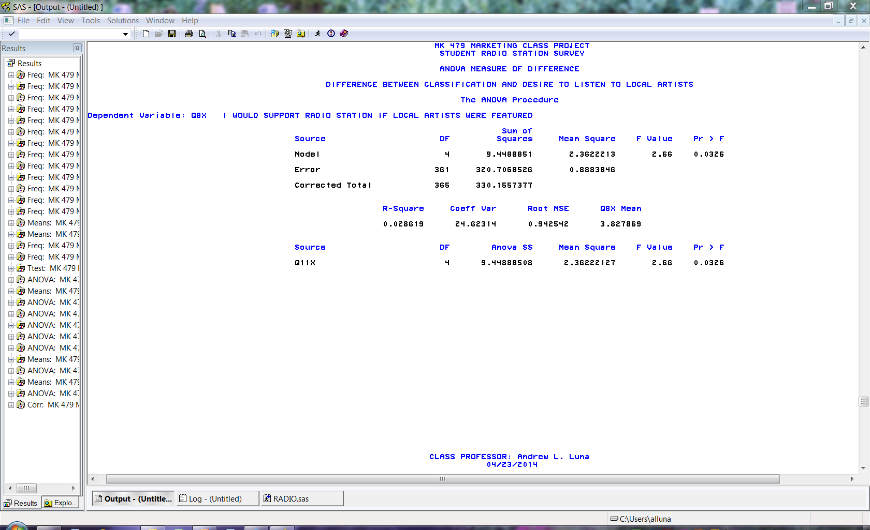

Slide 160
You Are Not Done Yet!!!
If the ANOVA test determines a difference exists, it will not indicate where the difference is located
You must run a follow-up test to determine where the differences may be
G1 compared to G2
G1 compared to G3
G2 compared to G3

Slide 161
Running the Tukey Test
The "Honestly Significantly Different" (HSD) test proposed by the statistician John Tukey is based on what is called the "studentized range distribution.“
To test all pairwise comparisons among means using the Tukey HSD, compute t for each pair of means using the formula:
$$t_{s}=\frac{M_{i}−M_{j}}{\sqrt{\frac{MSE}{n_{h}}}}$$
Where M_{i} – M_{j} is the difference ith and jth means, MSE
is the Mean Square Error, and n_{h} is the harmonic mean
of the sample sizes of groups i and j.

Slide 162
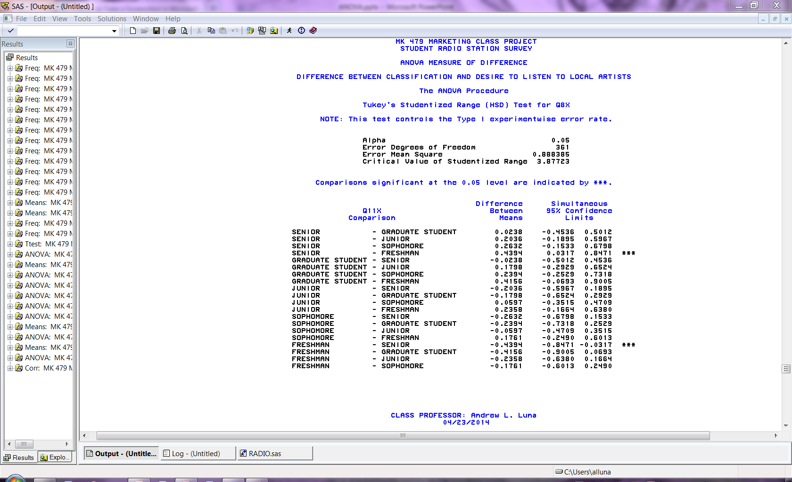

Slide 163
Results of the ANOVA and Follow-Up Tests
If the F-statistic is significant, then the ANOVA indicates a significant difference
The follow-up test will indicate where the differences are
You may now state that you reject the null hypothesis and indicate which groups were significantly different from each other

Slide 164
Regression Analysis
The description of the nature of the relationship between two or more variables
It is concerned with the problem of describing or estimating the value of the dependent variable on the basis of one or more independent variables.

Slide 165
Regression Analysis
Around the turn of the century, geneticist Francis Galton discovered a phenomenon called Regression Toward The Mean. Seeking laws of inheritance, he found that sons’ heights tended to regress toward the mean height of the population, compared to their fathers’ heights. Tall fathers tended to have somewhat shorter sons, and vice versa.
y
x

Slide 166
Predictive Versus Explanatory Regression Analysis
Prediction – to develop a model to predict future values of a response variable (Y) based on its relationships with predictor variables (X’s)
Explanatory Analysis – to develop an understanding of the relationships between response variable and predictor variables

Slide 167
Problem Statement
A regression model will be used to try to explain the relationship between departmental budget allocations and those variables that could contribute to the variance in these allocations.

Slide 168
Simple Regression Model
$$\left(y\right)=a+bx$$
$$Slope \left(b\right)=(NΣXY −\left(ΣX\right)\left(ΣY\right)))/(NΣX2 −\left(ΣX\right)2)$$
$$Intercept \left(a\right)=(ΣY−b\left(ΣX\right))/N$$
Where:
y = Dependent Variable
x = Independent Variable
b = Slope of Regression Line
a = Intercept point of line
N = Number of values
X = First Score
Y = Second Score
ΣXY = Sum of the product of 1st & 2nd scores
ΣX = Sum of First Scores
ΣY = Sum of Second Scores
ΣX² = Sum of squared First Scores

Slide 169
Simple regression model
y
Predicted Values
Residuals
Slope (b)
Actual Values
x
Intercept (a)

Slide 170
Simple vs. Multiple Regression
Simple: Y = a + bx
Multiple: Y = a + b₁X₁ + b₂ X₂ + b₃X₃…+b_{i}X_{i}

Slide 171
Multiple regression model
Y
X₁
X₂

