Slide 1
Memory and Concentration
University Advising Services
Notes:
Please see the notes in this power point presentation in edit mode for more information.

Slide 2
Memory and Concentration
Memory
Knowledge
Concentration
Managing Memory
Mneumonic Devices
Effeciency
Notes:
Please see the notes in this power point presentation in edit mode for more information.

Slide 3
Memory
Sensory memory
Short-term memory
Long-term memory
Notes:
There are three components of memory: sensory memory, short-term memory, and long-term memory.

Slide 4
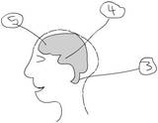
Memory
Sensory memory (SM) holds information for about 20-30 seconds
Short-term memory (STM) holds information temporarily
Long-term memory (LTM) involves permanent storage of information
Notes:
There are three components of memory: sensory memory, short-term memory, and long-term memory.
Sensory memory (SM) holds information for about 20-30 seconds, after which time it is lost unless it is stored in short-term memory.
Short-term memory (STM) holds information temporarily. This is what happens when you cram.
Long-term memory (LTM) involves permanent storage of information. This takes time and effort, usually involving repetition.
Diagram: “5” is the new brain – where new information enters, “4” is the limbic system, “3” is the reflex brain

Slide 5
Memory
Notes:
Encoding and retrieval are intricately linked to memory. They refer to the processes of moving information to and from short-term memory and long-term memory. Encoding means linking new information to existing knowledge so that the new information is more meaningful.

Slide 6
Memory
There is an article out 2/9/2012 in the Wall Street Journal:
“Memory Gets Jolt in Brain Research”
A Treatment for Parkinson’s disease may improve memory.
Notes:
http://online.wsj.com/article/SB10001424052970203315804577211351204163814.html
2/9/2012
By: Shirley Wang

Slide 7
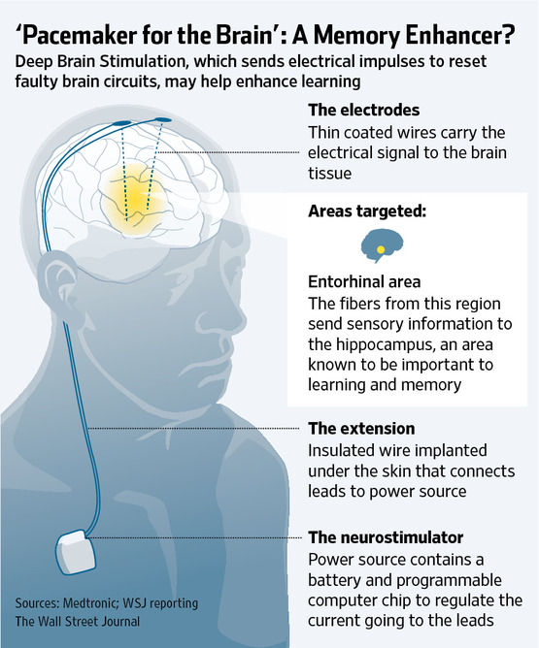
Notes:
http://online.wsj.com/article/SB10001424052970203315804577211351204163814.html
Article from the Wall Street Journal about memory and utilizing electrical impulses to improve memory.

Slide 8
Knowledge
Each of us has learning abilities and learning disabilities
College instructors give you information but you have to create the knowledge
Notes:
Each of us has learning abilities and learning disabilities. Learning is not an incremental, straight-line process. Learning takes time and there are bumps in the road. An educational system passes along information, not knowledge. Teachers give you the information but you have to create the knowledge.

Slide 9
Concentration
The ability to pay attention is vital to memory because it is the process that moves information…
Sensory Memory → Short-Term Memory
Notes:
Concentration: The ability to pay attention is vital to memory because it is the process that moves information from sensory memory to short-term memory. So you can see the connection between memory and concentration.

Slide 10
Concentration
So, how do you “concentrate”?
Repeat the information out loud
Write down the information to review/repeat later
Notes:
So, how do you “concentrate”?
Repeat the information out loud
Write down the information to review/repeat later – it is difficult to learn brand new information you are just hearing for the first time while you are in class, you need time to repeat and review so you write it down or record it.

Slide 11
Concentration
It takes time to learn something for the first time.
It is faster to re-learn something.
Notes:
We store more information than we are able to retrieve, but it is there somewhere in our memory because with a “refresher” we can bring it to light.

Slide 12
Learning Takes Time and Work
Distinguish memory from comprehension Short-Term Memory → Long-Term Memory
Transform information into different sensory channels
Look for the underlying structure of the information
Notes:
Distinguish memory from comprehension – memorizing and understanding are two different things. Overall comprehension is more important than memorization.
Transform information into a different sensory channel. Not just hear, but see and touch too.
Look for the underlying structure in what you are learning. Connect everything so that there are no isolated pieces of information. Making connections between the material you know and the material you are trying to learn will help you recall the less familiar material when you need it.

Slide 13
Tips for Managing Memory
Create connections:
“Brainstorm” the information
Create or recall examples
Notes:
If you are unable to remember something, brainstorm the information you do know related to the topic. If two concepts are similar and you remember information about one of them, recall this information and you may find that you are able to recall the information about the other.
In the learning process, try to create examples to help you recall the information. If the professor used examples in class, recall his/her examples.

Slide 14
Tips for Managing Memory
Make a connection between new information and what you already know.
Notes:
Collaborate. College students who perform together in teams perform better than if they work alone. There is commitment in a group. Some people get certain concepts while others don’t. Groups require communication…
Communication – saying what you are studying out loud, helps you order it in your head and learn it.

Slide 15
Tips for Managing Memory
Commit to reviewing course material frequently
Avoid lengthy study periods *Primacy-Recency
Notes:
Commit to Reviewing Course Material frequently – Spend time each day reviewing notes. This begins the process of collecting information in your brain, sorting it, processing it, and placing the information into long term memory.
Avoid lengthy study periods. Divide this time into short blocks of time. Mental activity is at its peak at the beginning of a block of study time and at the end of that period of time. Shorten everything in between: *Primacy-Recency- We learn more from the beginning and the ending of our study sessions, and less from the middle.

Slide 16
Tips for Managing Memory
Collaborate - College students perform better in teams
Communicate - Say what you are studying out loud, it helps to order it and learn it
Notes:
Collaborate. College students who perform together in teams perform better than if they work alone. There is commitment in a group. Some people get certain concepts while others don’t. Groups require communication…
Communication – saying what you are studying out loud, helps you order it in your head and learn it.

Slide 17
Tips for Managing Memory
“To teach is to learn twice”
-Joseph Joubert
Notes:
Collaborate. College students who perform together in teams perform better than if they work alone. There is commitment in a group. Some people get certain concepts while others don’t. Groups require communication…
Communication – saying what you are studying out loud, helps you order it in your head and learn it.

Slide 18
Mnemonic Devices
Notes:
Mnemonic is pronounced "neh-MON-ik“ and it means “memory.”

Slide 19
Mnemonic Devices
Acronyms are formed from the first letter of each detail you are trying to remember.
Do you know - who is Roy G. Biv?
Notes:
Acronyms are formed from the first letter of each detail you are trying to remember.

Slide 20
Mnemonic Devices

Slide 21
Mnemonic Devices
Acronyms are formed from the first letter of each detail you are trying to remember.
Roy G. Biv
Notes:
Acronyms are formed from the first letter of each detail you are trying to remember. Roy G. Biv is the colors of the rainbow, in order that they appear.

Slide 22
Mnemonic Devices
Acronyms are formed from the first letter of each detail you are trying to remember.
For Example:
Do you know the names of all of the “Great Lakes?”

Slide 23
Mnemonic Devices
Acronyms are formed from the first letter of each detail you are trying to remember.
For Example:
Do you know the names of all of the “Great Lakes?” HOMES

Slide 24
Mnemonic Devices
Acronyms are formed from the first letter of each detail you are trying to remember.
HOMES Huron, Ontario, Michigan, Erie, Superior
Notes:
HOMES (The great lakes: Huron, Ontario, Michigan, Erie, Superior).

Slide 25
Mnemonic Devices
Can you name all of the planets in our solar system?
Notes:
Can you name all of the planets in our solar system?

Slide 26
Mnemonic Devices
Acrostic is a phrase or sentence in which each word begins with the first letter of the details being learned.
“My Very Educated Mother Just Served Up Nachos.”
Notes:
Acrostic is a phrase or sentence in which each work begins with the first letter of the details being learned. “My Very Educated Mother Just Served Up Nachos.”

Slide 27
Mnemonic Devices
Acrostic is a phrase or sentence in which each word begins with the first letter of the details being learned.
“My Very Educated Mother Just Served Up Nachos.” (Mercury, Venus, Earth, Mars, Jupiter, Saturn, Uranus, Neptune)
Notes:
Acrostic is a phrase or sentence in which each work begins with the first letter of the details being learned. “My Very Educated Mother Just Served Up Nachos.” (Mercury, Venus, Earth, Mars, Jupiter, Saturn, Uranus, Neptune)

Slide 28
Chunking
Can you remember this number?
2009177618125678
Notes:
Chunking – mentally grouping details. (1-800-NEW-POOL, or 738-1492). Can you remember this 16 digit number? 20091776181215678

Slide 29
Chunking
Chunking – mentally grouping details
EX: 1-800-NEW-POOL
or 738-1492
Notes:
Chunking – mentally grouping details. This is how we learn phone numbers and social security numbers. (1-800-NEW-POOL, or 738-1492)

Slide 30
Chunking
Now can you remember this number?
2009 1776 1812 5678
(this is called chunking!)
Notes:
Now---try to break it down in groups of 4 numbers: 2009 1776 1812 5678 (this is called chunking!)
Other memory devices include putting what you need to learn to music. –School House Rock!

Slide 31
Efficiency
Streamline information - Repeat it or compare it
Inefficient processing of information is the weak link in the memory chain
Notes:
You are faced with so much information you have to find ways to streamline that information. You can repeat information over and over until it is absorbed. You can compare new information with information you already have stored.
For most students, inefficient processing of the information in their working memory is the process that hinders them most. A student who has put off review until the evening before a major test will discover that much of the information just isn’t there anymore. Use working memory to learn what you need for the test and keep that information in your head.

Slide 32
Memory and Concentration
YouTube video – Memory and Concentration

Slide 33
References
Downing, S. 2008. On course: Strategies for creating success in college and in life. 5th edition. Boston: Houghton Mifflin Co.
Walther, D. R. 1994. Toolkit for college success. Belmont, CA: Wadsworth Publishing Company
Muskingum College. (2010). Learning Strategies Database. Retrieved January 16, 2011, from Muskingum College: www.muskingum.edu/~cal/database/general/index.html.
Begley, S. (2011). Can you build a better brain. Retrieved January 16, 2011, from Newsweek: http://www.newsweek.com/2011/01/03/can-you-build-a-better-brain.html.

Slide 34
For More Information
Contact: Dr. Matt Price Learning Support Coordinator/Academic Advisor University of North Alabama
The Commons 220
256-765-5949
mprice2@una.edu

