Slide 1

Note Taking Skills
Academic Advising Center
Notes:
Please see notes throughout the slide show for more information.

Slide 2

Most Important*
*Review your notes
within 24 hours of taking them
Notes:
Review notes from previous class meeting – this is the basis of why we need to learn how to take good notes. If you take good notes, review your notes within 24 hours of the class session and continue to review your notes every day, you will know the material for the test.

Slide 3
One hour spent studying soon after class will do as much as several hours of studying a few days later!
Notes:
Review lecture notes just after class:
The first 24 hours are critical. Forgetting is greatest within 24 hours without review! Review your notes!!! Get home late from work at night? Review your notes before you go to bed. Just read them and think about them, even if it is for ten minutes. You have ten minutes before the next class? Review your notes.

Slide 4
Before Class
*Read assigned materials*
Write down any questions and prepare to ask them in class
Notes:
Any preparation who do before class will help you know what to write down and makes taking notes easier.
Write down any questions you may have.
Read assigned materials - Take notes on homework assignments before class - Prepare a list of questions based on homework assignments for class. Don’t walk into class cold. If you really want to do well, be prepared.

Slide 5
Before Class
Always bring paper/pen/pencil
Have an organized notebook
Notes:
Have notebook organized ahead of time – headings and dates are very helpful when you are needing to look back for something.
Always bring paper and pen/pencil to class – Do NOT show up to class without a way to write and something to write on. Get note taking supplies that fit your style. Pen? Pencil? Spiral notebook or three ring? If you show up to class with nothing to write with or on you might as well show up with a big sign around your neck that says, “I’m not ready for college.”

Slide 6
Before Class
Just something to think about…
  Laptops are becoming more accepted, but they are distracting to the presenter and other students.
  Recording a lecture is time-consuming.
  Rewriting notes is time-consuming.
Notes:
A laptop is distracting – try paper and pencil. Recording a lecture is fine if that works for you but you will be spending double the time listening to the lecture. Some people prefer to rewrite their notes. Keep in mind that this takes double the amount of time. Taking quality notes the first time and adding to them may be a more productive activity.

Slide 7

During Class
Sit near or at the front of the classroom
Notes:
Sit near the front of the classroom – there is evidence that students who sit toward the front of the room make higher grades then those who sit in back.
Why? You are better able to focus on what is being said - you are more likely to participate in class discussion – you are more likely to take the class seriously - you can see the board - less distractions – the professor can see you (professors are human – they will get to know who you are and know you showed up for class/participated and may give you the benefit of the doubt.)

Slide 8

Techniques for Taking Notes
Record only important ideas
Listen and look for cues
“The main point is…”
“In conclusion…”
“Obviously…”
Notes:
Record only important ideas in your notes. Don’t write everything.
Listen and look for cues. “The main point is…” “In conclusion…” “Obviously…”
Professors are not like elementary or high school teachers. They assume you know much of this information.

Slide 9
During Class
Write key words or short phrases
Leave space between topics
Notes:
Use key words or short phrases – don’t waste too much time and effort - use abbreviations and acronyms.
Leave space between topics – Leaving white space within your notes is important. This allows room to go back and add more information later or summarize the information that is there. It provides room for a concept map or space to write the definitions of terms you have encountered.

Slide 10
During Class
Write page numbers mentioned by the instructor
Write down your professor’s examples
Notes:
Write page numbers referenced by the instructor for future reference.
Write down your professor’s examples, you may see them again on a test.

Slide 11
Techniques for Taking Notes
Note what is on the board, power point, handout
Listen for answers to your prepared questions
Ask questions!!
Notes:
It is important to pick out the details, spend your valuable time on them, and avoid less important concepts. Successful students spend some time weeding out information seen as less important to the professor. You might find the most successful students in class are the ones who take the time to ask the professor what the test will be like, what will be on the test, and what will NOT be on the test.
Listen for answers to your prepared questions. Ask questions!! Students should be less concerned about sounding silly and take advantage of the fact that their professor is there and ask questions. If you have a questions, so do other students. And, HELLO! You’re paying for it!!

Slide 12
Techniques for Taking Notes
Summary
Outline
Concept Maps
Cornell Method
Fishbone Diagrams

Slide 13

Note Taking Method
Summarizing Information
Make your notes brief
Use abbreviations and symbols:
@ b/c w/ w/o ex.
+ > < * #
Notes:
Make your notes brief: Don’t use a sentence where you can use a phrase and don’t use a phrase where you can use one word. Don't write down everything that you read or hear – only record what is important. Your notes are for you to review information quickly not rehash everything that you hear. (This also relates to recording lectures – you spend double your time when you attend class then re-listen to the lecture.) Taking good notes gives you a way to review the class in a short period of time. Use abbreviations and symbols to help keep important information in and the “junk” out.

Slide 14
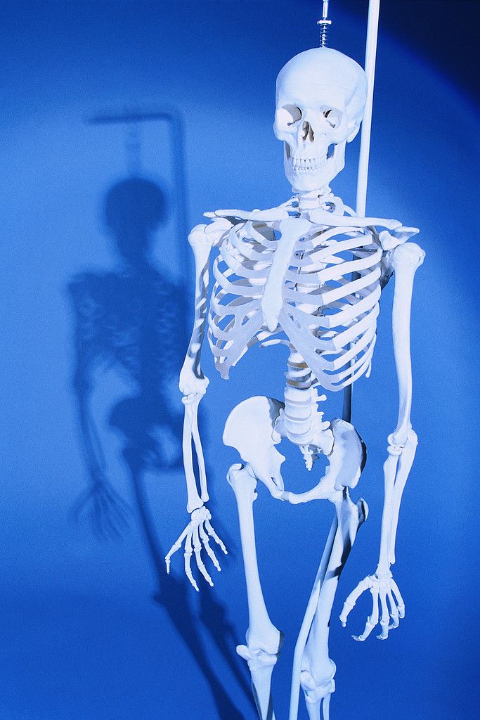
Note Taking Method
The Outline
The skeletal form
of information
Notes:
Outlining points out the organization of the information. It is the skeleton of the information – it gives form to what you are examining and what has been built. Unfortunately, a student’s first experience with an outline is not always positive, but outlines are very useful in notetaking, they highlight important information and provide something to build on.

Slide 15
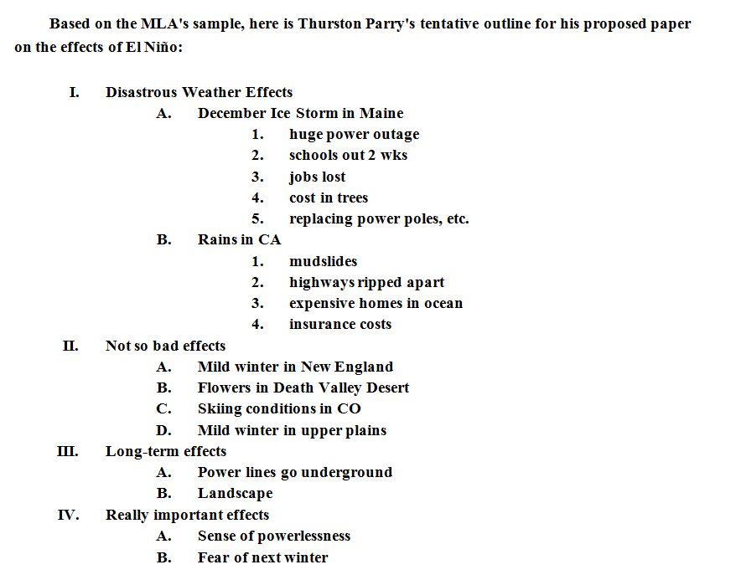
The Outline
Notes:
This is an example of an outline created for a paper but is a good example of what you can create out of class notes. Corresponding numbers and letters have related information. Indention helps you distinguish major from minor points. Outlines allow for a lot of white space which can be used to add more information later.

Slide 16
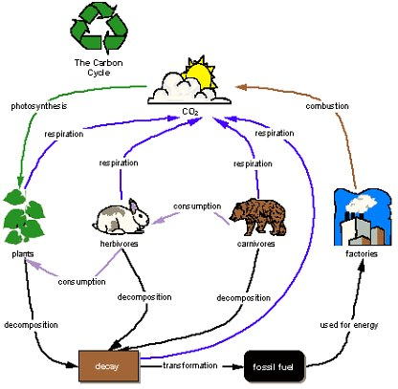
Concept Map
Notes:
A concept map provides visual clues to how ideas are related. They can be drawn in different ways and you have to decide what works best for you.

Slide 17
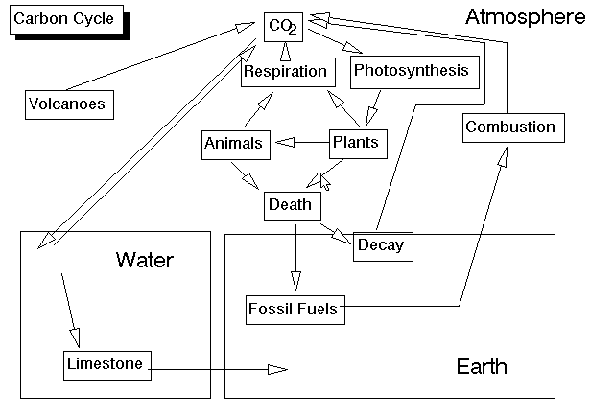
Concept Map
Notes:
This is another example of a concept map of the same topic. You can see how they are different interpretations of the same thing. When it is time to remember this cycle, the visual representation is likely to pop into your mind.

Slide 18
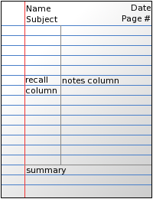
Note Taking Method
Cornell Method
Notes:
The Cornell Method is a proven method of note taking that divides the page into three parts, as illustrated. The notes are taken in the right column and the recall column is used later to write key words & phrases that will make the review process easier. The summary creates another opportunity to put the notes in your own words and provides something valuable for review later.

Slide 19
Note Taking Method
Cornell Method
Notes:
Be sure to add date!!

Slide 20
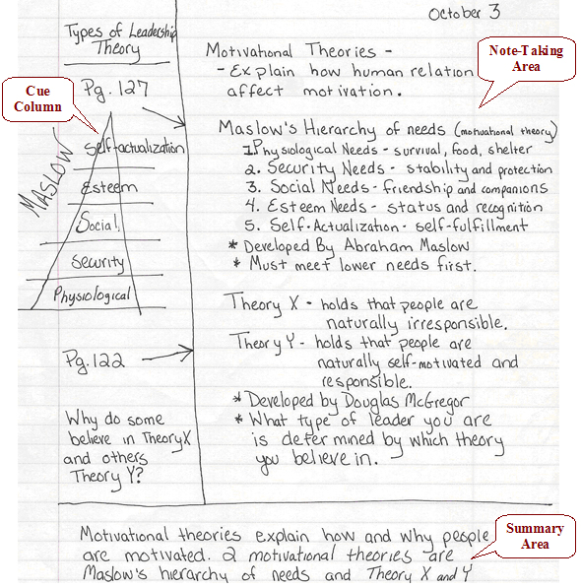
Cornell Method
Notes:
This slide offers an example of how to use the Cornell Method. Notice the diagram to the left, and the question at the bottom left – a possible test question!

Slide 21
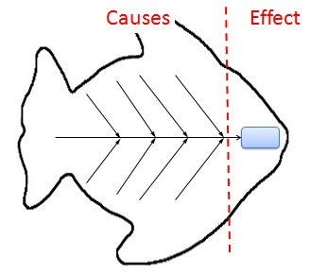
Note Taking Method
Fishbone Diagram
(forms a conceptual map where information is directly related)
Notes:
Can help in determining the root causes of a problem or quality characteristic using a structured approach.
Encourages group participation and utilizes group knowledge of the process.
Uses an orderly, easy-to-read format to diagram cause-and-effect relationships
Indicates possible causes of variation in a process
Increases knowledge of the process
Identifies areas where data should be collected for additional study

Slide 22
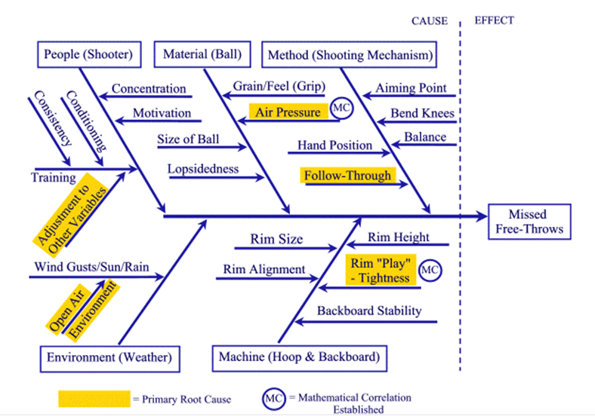
Note Taking Method
Notes:
Example of a fishbone diagram - missed free-throws

Slide 23
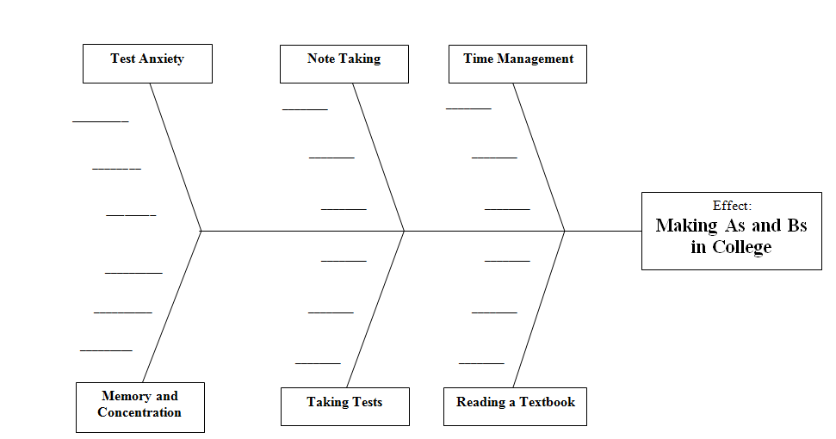
Note Taking Method
*ACTIVITY *
Notes:
Make your own diagram using some basic concepts related to cause and effect.

Slide 24
After Class
Review your notes ASAP
Say important concepts and ideas out loud
Notes:
REVIEW YOUR NOTES! As soon after class as possible, review. Fill in missing information and review as you are more likely to remember this information if you review it within 24 hours.
Say important concepts and ideas out loud. Explaining the information helps you to sort through the information, put it together, and learn it. You include multiple senses when you do this. (You are seeing it and hearing it). Again, using multiple senses reinforces the information into your long term memory.

Slide 25
After Class
Compare notes with classmates
Review your notes regularly
Notes:
Compare notes with classmates.
Review your notes periodically – certainly within 24 hours but also each day, even a few minutes a day will help you remember the information in the long run.

Slide 26
Note Taking Method
Dartmouth College. 2011. Academic Skills Center. Retrieved January 23, 2011from http://www.dartmouth.edu/~acskills/success/notes.html.
Downing, S. 2008. On course: Strategies for creating success in college and in life. 5th edition. Boston: Houghton Mifflin Co.
Walther, D. R. 1994. Toolkit for college success. Belmont: International Thomson Publishing.
Muskingum College. (2010). Learning Strategies Database. Retrieved January 16, 2011, from www.muskingum.edu/~cal/database/general/index.html.

Slide 27
For More Information
Contact:
Heather Unger-Robertson
Learning Support Coordinator/Academic Advisor
University of North Alabama
Keller Hall 127
256-765-5949
hurobertson@una.edu

