Slide 1
How to Do a Literary Analysis (the Right Way)
By
Kathleen Franks
Writing Consultant
November 2013
University of North Alabama
Center for Writing Excellence

Slide 2

What is a literary analysis?
A literary analysis looks at a literary work (a story, a book, a play, an article, poem, etc.) and examines it
Basically, you’re taking a literary work, putting it under a microscope, and seeing how and why its parts work.

Slide 3

Wait, I have to analyze a whole work?!
No! When you do a literary analysis, you look at its parts and analyze how and why the parts function in the work itself.
Usually a literary analysis will analyze just one part—analyzing more than one is usually too big for a short analysis to do efficiently.
Keep in mind that an ANALYSIS is NOT a summary!
Summary: What happened?
Analysis: How and why did it happen?

Slide 4
Common Literary concepts
Theme
Tone
Characters
Symbolism
Motifs
Metaphors
Point of view
Setting
Diction/Vocabulary
Allusions
Context
Connotation
Author’s background and beliefs
Connotation:
House or home?

Slide 5
Some brief definitions
Theme: the main idea of a work of literature that unifies and runs through the whole work. The theme can be simple or complex. (There can be more than one theme, but your literary analysis should only focus on one.)
Macbeth: Guilt
The Great Gatsby: The inability to recapture the past
Tone: the mood of the piece. Usually the diction (the words and how they are used) of the piece conveys the tone. Tone can affect the way you as a reader read the piece.
Tone is especially important in poetry.
“Humanity i love you because you / are perpetually putting the secret of life in your pants and forgetting / it’s there and sitting down / on it” –E.E. Cummings’ “Humanity i love you”
This quote conveys a sarcastic—maybe even angry or bitter—tone.

Slide 6
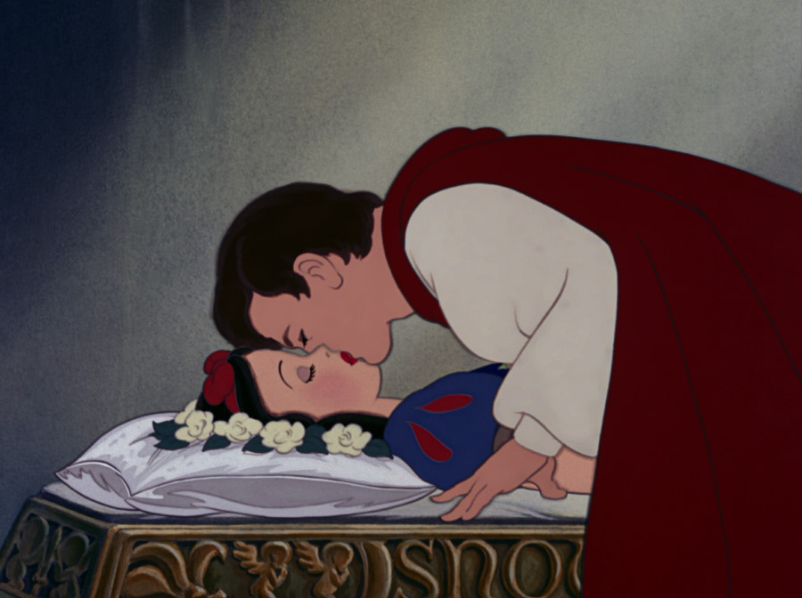
Some brief Definitions
Symbolism: A symbol is something that stands for something else.
Heart: love, emotion
Winter: death, old age, sadness
Motif: A recurring idea, symbol, image, subject, etc. in a piece of work. A motif is “very noticeable and play[s] a significant role in defining the nature of the story.”
Prince Charming in Fairy Tales
Damsel in Distress
http://literary-devices.com/content/motif

Slide 7
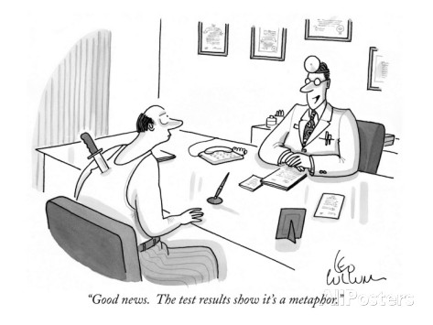
Some brief definitions
Metaphor: like a simile, only you say something IS something that it isn’t. Metaphors aren’t literal and carry with them a much deeper meaning than a simile.
Simile: A woman’s heart is like an ocean.
Metaphor: A woman’s heart is an ocean.
Metaphor: “Your words are a knife in my back.”
By Leo Collum
Appearing in the New Yorker
http://www.condenaststore.com/-sp/Good-news-The-test-results-show-it-s-a-metaphor-New-Yorker-Cartoon-Prints_i8479068_.htm

Slide 8
Some brief definitions
Point of view: Who is telling the story? This is an important point to consider when you read because it determines perspective. There are three basic points of view:
Third person: The story is being told from an outside perspective
Animal Farm
Harry Potter series
Second person: RARELY used. The character will speak directly to you.
First person: The person telling the story is a character in the story. It’s important to note that first person narrators are NOT always reliable sources… they are characters, and are therefore ruled by emotions and biases.
To Kill a Mockingbird: told from Scout’s point of view
Fight Club: told from the Narrator’s point of view
The Great Gatsby: told from Nick Carraway’s point of view

Slide 9
Some brief definitions
Setting: where the story takes place. The setting can determine much about the story based on context. Setting can be very important in the reading of a work.
Time
Place
Society
Allusion: a reference, indirect or direct, in a work TO a work, historical event, period, or figure, etc.
“I am not Prince Hamlet” –a direct allusion to Hamlet in “The Love Song of J. Alfred Prufrock” by T. S. Eliot
“Four score and seven years ago our fathers brought forth on this continent, a new nation” –an indirect allusion in “The Gettysburg Address” to the Declaration of Independence

Slide 10
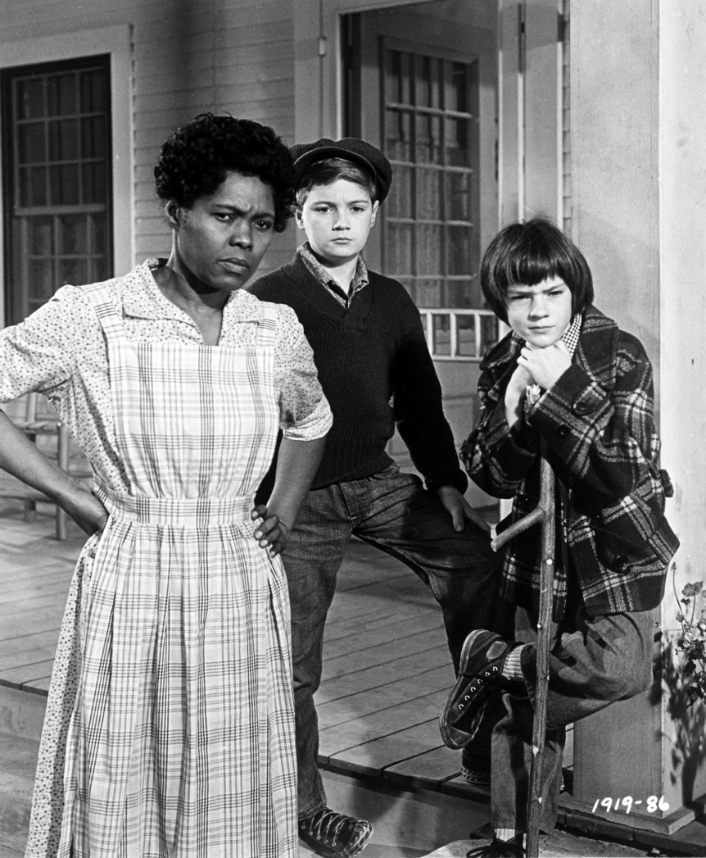
Some brief definitions
Context: the ideas, history, events, or circumstances surrounding a work or a part of a work. Often you will have to look for context clues in a work to figure out what a word or sentence means. Context many times dictates what is important in a piece, or why the piece itself is important.
What is the context of To Kill a Mockingbird?
Rural South before the Civil Rights Movement
Small town
Racial prejudice
To Kill a Mockingbird (1962)

Slide 11
Some brief definitions
Connotation: connotation is the associated meaning a word carries with it, but it’s not necessarily the dictionary meaning. Many times connotation will change depending upon the person. A word can have a negative or positive connotation. (Sometimes connotation is subjective.)
Home: happiness, togetherness, love, warmth
Childish vs. Childlike
Someone is being immature, annoying, selfish, etc.
Someone is innocent and sweet

Slide 12
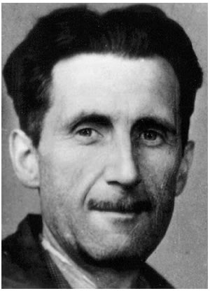
Some brief definitions
Author’s background and beliefs: Many times an author’s personal life, beliefs, and ideas will spill over into his or her work. Knowing a little about the author will help you figure out what a work is about, what it is trying to say, and why it is trying to say it.
George Orwell:
Considered himself a socialist
Wrote about poverty in England in the 1940s
Fled Spain when the communists began to fight against the socialists
Orwell’s Animal Farm:
Published in 1945—just after WWII
Focuses on the bad effects of Communism
Socialism vs. Communism
http://www.bbc.co.uk/history/historic_figures/orwell_george.shtml

Slide 13
Some Key Questions
WHY is the concept being used?
Is the author trying to prove a point?
Does the concept stand for something bigger?
HOW is it being used?
How does it affect the reading?
What feelings does it evoke in the reader?
WHAT does the concept contribute to the work?
Does the concept have a bigger meaning/importance?
Does the concept relate to or comment on society, history, religion, etc.?

Slide 14
What does an analysis have?
Thesis Statement
What’s the main idea of your analysis? What are you setting out to prove with your paper?
Argument (First)
What do you think the work/concept is saying/doing?
EVIDENCE (Second)
What from the text made you think of your idea?
QUOTATIONS
Discussion (Third)
Why did the text make you think that way?
How does the text support your claim?

Slide 15
What is a thesis statement?
Your thesis statement is the main idea of your paper. It will give the reader an idea of what your paper is about and where you’re going with it. It’s usually at the end of your introduction.
Should be specific/narrow
“Three symbols of death in literature are night, darkness, and winter.”
The reader knows the three specific points you will discuss
“The use of the color green in The Great Gatsby signifies the preoccupation of society with money.”
The reader knows your paper will focus on the color green and how it represents money in The Great Gatsby

Slide 16
Thesis statements: what to avoid
General statements
“Abortion is a controversial issue.”
There are many reasons why abortion is controversial. The reader doesn’t know where your paper is headed. What are you going to talk about? Why is it important?
Statements that don’t build an argument
“This paper is about the theme of loneliness in American literature.”
Your paper is about loneliness. So what?
“A lot”
Vagueness
“some” and “any” words: sometimes, anyone

Slide 17
How to write a good thesis
Make a claim
Don’t just state a fact—that isn’t an argument
Don’t state an opinion
Be specific—don’t make your argument too broad to cover in your paper
Be clear: what is your argument?
You need to sound sure/convincing
Bad example: “Videogames may increase violence.”
Good example: “Violent videogames increase violence among the adolescent population.”

Slide 18
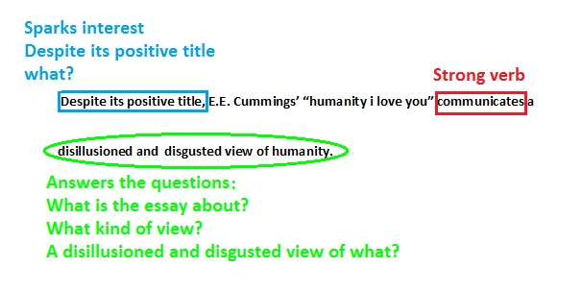
a strong thesis: example

Slide 19
How do I get started?
Choose a concept
Brainstorming
What argument can you make?
What evidence could you use to support your claim about your argument?
Do you have enough reasonable evidence?
Are there places in the text you can quote to support your claim?
Are there secondary sources you could use to support your claim?

Slide 20
Brainstorming
Brainstorming helps you generate ideas
Freewriting: Write whatever comes to your head. It can be just a list or words, or sentences. It’s like word association. No rules, just write.
Word clusters: Put the main idea in the center and branch related ideas off of it.
Lists

Slide 21
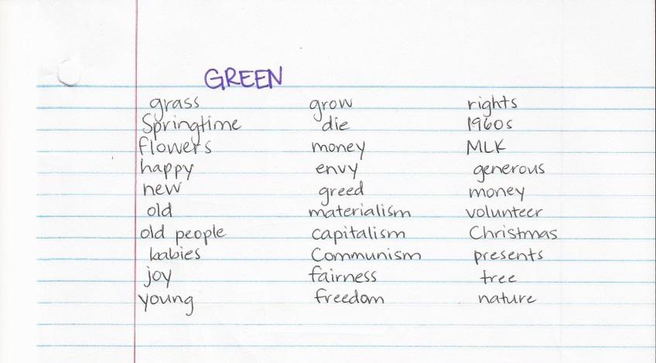
Freewriting
Although not all of the ideas will make sense, it may surprise you how many of them do. Now you have a starting point!

Slide 22
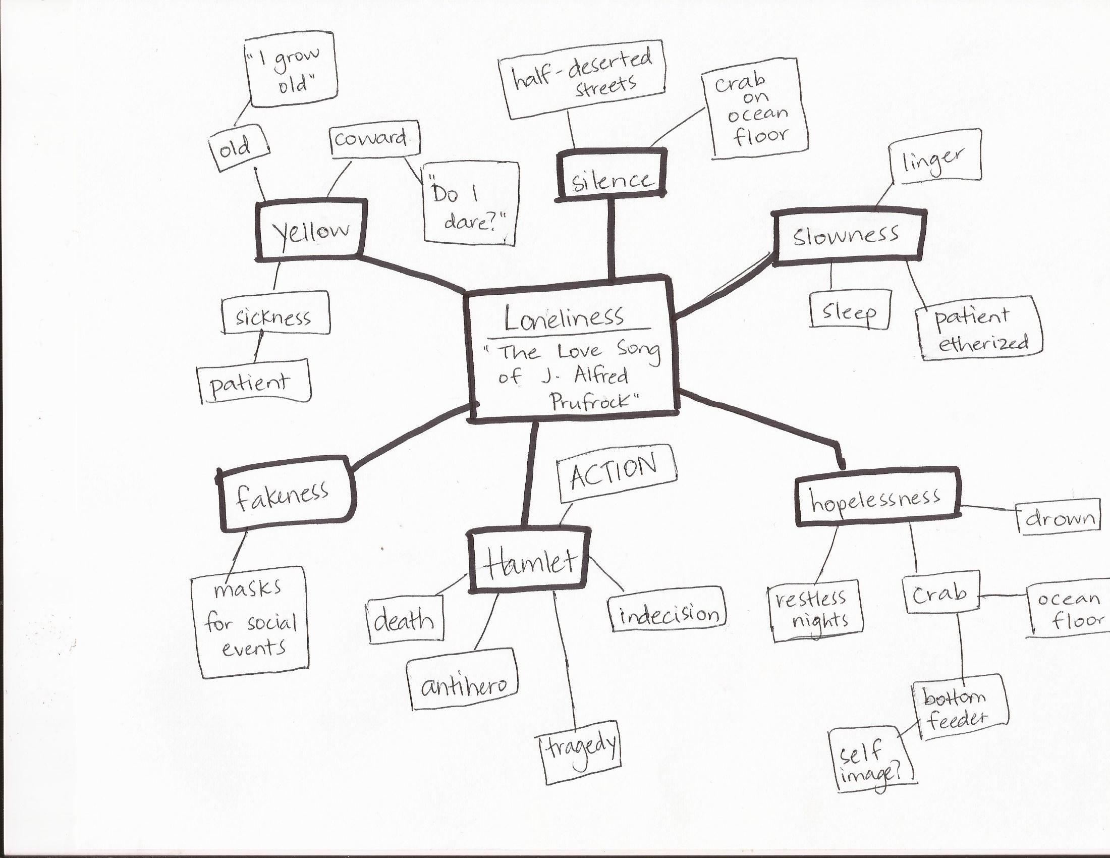
Word cluster

Slide 23
Organizing ideas
Most essays have three parts
Introduction
Body
Conclusion
Most essays have three main ideas
Paragraphs
It’s best to leave your strongest idea for last
Many people like to organize their essays like this:
Second strongest idea- to interest the reader
Weakest idea
Strongest idea- to end with a bang

Slide 24
Introduction
Your introduction should get the reader ready for the paper.
Some good things you could include:
An attention getter: a question, fact, quote, etc.
Small discussion about the work’s context
Be sure everything in your introduction is RELEVANT—meaning it adds something to your paper.
THESIS STATEMENT
Your introduction is probably going to be rather brief.

Slide 25
Body Paragraphs
Your body paragraphs are the heart of your argument.
Why should the reader believe what you’re saying?
Use sources to back yourself up.
Quotes from the text itself
Secondary sources
What other critics, authors, readers, etc. have said about the work
Websites
Magazines, journals, books, etc.
Use reputable sources: NOT WIKIPEDIA
BE SURE TO CITE THE SOURCES YOU USE!
Plagiarism is when you use someone else’s work (on purpose OR accidentally) as your own without giving that person credit.
Plagiarism is a serious offense that can get you thrown out of college.

Slide 26
Talking about literature
Talk about literature in the present tense—even if the literature was written or takes place a long time ago.
Talk about the author in the present tense when you’re talking about what the author does in the text—even if the author is dead. (If you’re talking about biographical information, you can use past tense.)
Stick to writing in the THIRD PERSON, unless otherwise specified by your professor.
Don’t use I, you, we, us, etc.
Use active voice
Active voice: I threw the ball.
Passive voice: The ball was thrown.
Refer to the author using last name or first and last name

Slide 27
examples
Shakespeare’s Hamlet
“As Polonius hides behind the curtain, Hamlet stabs him.”
“Shakespeare reveals Hamlet’s madness.”
“Shakespeare wrote sonnets and plays.”
Written circa 1602
Shakespeare (1564-1616)
Present tense: This is what the author is doing in the work.
Past tense: This is what the
author did in life.

Slide 28
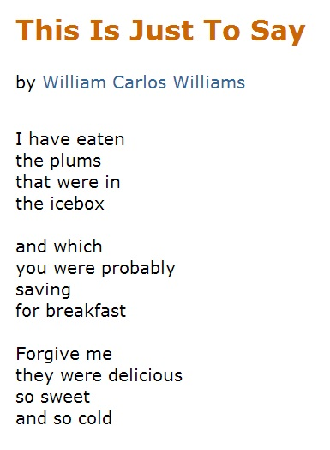
Talking about poetry
Williams, William Carlos. “This is Just to Say.” Poets. Academy of American Poets, n.d. Web. 24 Nov. 2013.

Slide 29
Talking about poetry
When you talk about poetry, you never say the AUTHOR says anything. The person who speaks in the poem is the speaker.
There aren’t characters in poetry. The author may write a poem from a totally different perspective than the one he or she has in real life, so saying that the author does or says something that the speaker of the poem does or says is neither accurate nor correct.
So, when you talk about “This is Just to Say” by William Carlos Williams…
WRONG: “Williams eats the plums from the refrigerator.”
RIGHT: “The speaker in ‘This is Just to Say’ eats the plums from the refrigerator.”

Slide 30
Using direct quotes
It is important to always have a signal phrase, or an introduction, to a quote
Jumping into a quote without introducing it will be too choppy
Always be sure to cite where your quote came from
In MLA format, give the author name and page number
When you use a longer quote (if it takes up 5 or more lines), use a block quote
Block quotes are indented ONE INCH
No quotation marks
Give citation AFTER the punctuation mark

Slide 31
Using Direct quotes
As a black humor novel, Catch-22 often discusses important issues of morality and meaninglessness in wartime: “Maybe a long life does have to be filled with many unpleasant conditions if it’s to seem long. But in that event, who wants one?” (Heller 40).
Signal phrase
Quote
Citation
Heller, Joseph. Catch-22. New York: Dell, 1955. Print.

Slide 32
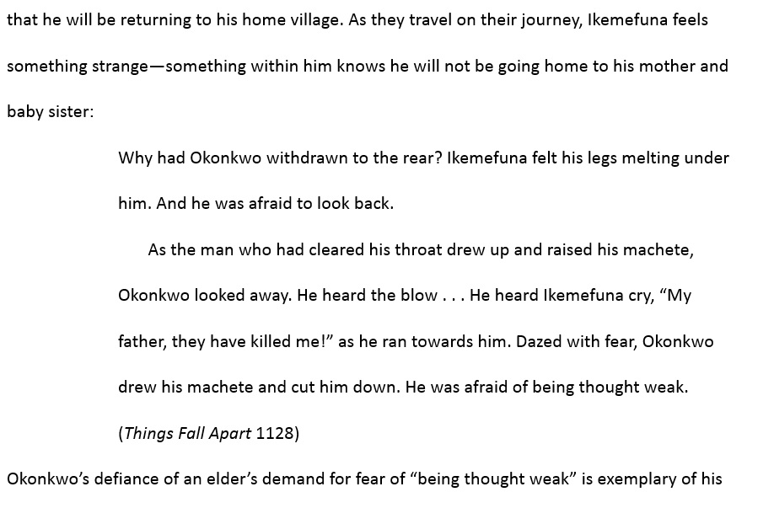
Using a block quote
Signal
phrase
1-inch indent
Continue your discussion without indenting
Franks, Kathleen. “The Collapse of Identity in Things Fall Apart.” 03 October 2013. Page 3.

Slide 33
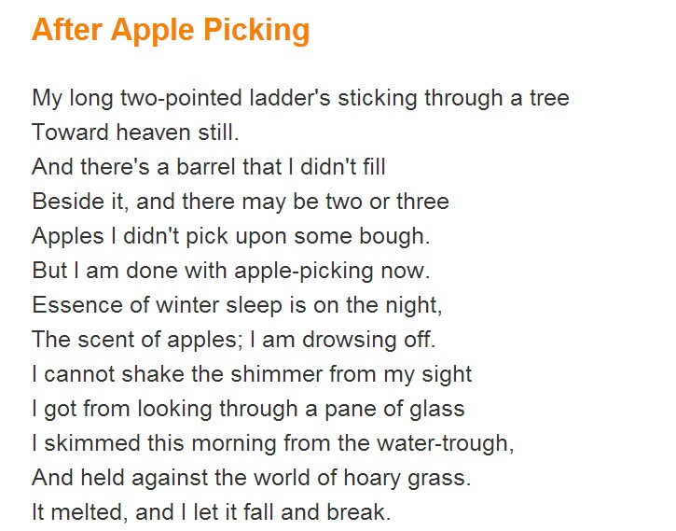
Using direct quotes: poetry
Quoting poetry in your paper is a little different than quoting prose
Because poetry has line breaks, you will have to signify these breaks with a slash (/)
Instead of page numbers, you will cite the poem using line numbers
by Robert Frost
“After Apple Picking.” Poem Hunter. Poem Hunter, n.d. Web. 24 Nov. 2013.

Slide 34
Direct quote: Poetry example
Take Note:
Use brackets around a letter when you must capitalize it (in the poem itself the word isn’t capitalized).
To denote line breaks, put a space before and after the slash.
Be sure to put your citation after the end quotation mark but before the end punctuation.
The speaker in “After Apple Picking” discusses the end of his life and the chances he did not take: “[T]here may be two or three / Apples I didn’t pick upon some bough / But I am done with apple picking now” (Frost 4-6).

Slide 35
Formatting titles
Italics: Major Works
Books: Jane Eyre, To Kill a Mockingbird
TV shows: Twin Peaks, CSI: Crime Scene Investigation
Plays: Much Ado About Nothing, Death of a Salesman
Movies: Breakfast at Tiffany’s, 2001: A Space Odyssey
Major poems: The Odyssey, Beowulf
Magazines: People, TIME
In quotations: Minor Works
Poems: “The Love Song of J. Alfred Prufrock”
Episodes of TV shows: “The One with the Fake Monica”
Songs: “I’ll Be Home for Christmas”

Slide 36
Let’s get to writing!
“Literature… is a way to understand life, to appreciate living, and therefore to participate in life to the fullest of your potential.”
Eric Chock
http://wingedword.wordpress.com/2010/08/02/some-of-my-favorite-quotes-about-literature/

